Slide 1
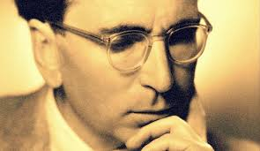
The Neuroscience of Trauma & Movement
2
Viktor Frankl Mind/Body & Soul
Trauma-Healing
Life Coaching Program Week 3

Slide 2
Somatic Coaching I
3

Slide 3
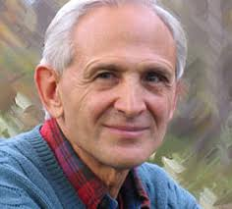
Week 3
What is Somatic Experiencing?
Expansion/Contraction
Helping Client Feel Safe
12 Exercises to Heal Trauma
Vagus Nerve/ Voo Sound Exercise

Slide 4
Preparatory
Tracking Skills
Discharging Activation

Slide 5
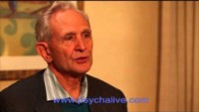
Peter Levine and Somatic Experiencing
Notes:
https://www.youtube.com/watch?v=00ReSznsv-g&feature=emb_logo

Slide 6
Amygdala overwhelms
Once the Amygdala becomes activated, flooding of adrenaline occurs to other parts of the brain and survival life force is utilized. This causes lasting changes in one’s instincts and sensations.
A person needs to learn how to expand and contract safely out of those sensations

Slide 7
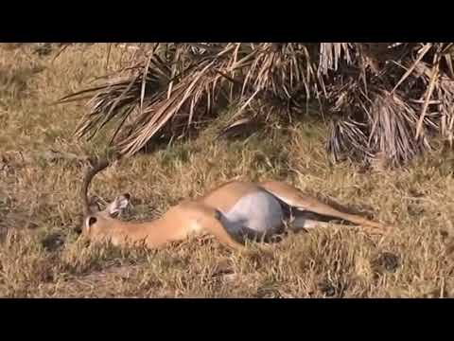
Tonic Immobility

Slide 8
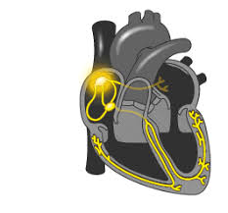
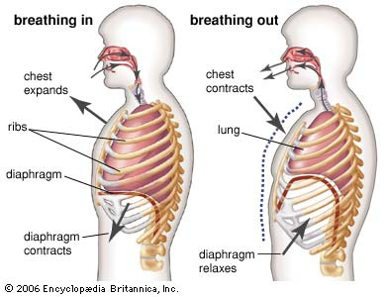
Expansion/Contraction
Heartbeat, Inhaling/exhaling, speaking/listening.
Heart contracts and expands

Slide 9
Interrupting Feedback
Traumatic patterns can be interrupted.
The nervous system’s rhythm can be reset by slowly experiencing contraction and expansion i.e. slowly moving the body with awareness.

Slide 10
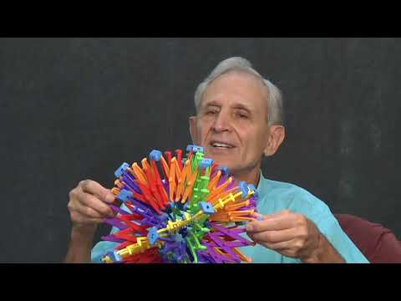
Peter Levine on Pendulation (Expansion/Contraction)
Notes:
https://www.youtube.com/watch?v=LiXOMLoDm68

Slide 11
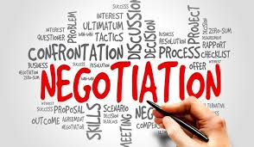
Renegotiation
Our goal is to help the client renegotiate what has occurred and to gently move out of freeze (habit, posture, tension).
We are not looking for a catharsis i.e. hitting the pillow. Rather, we seek to restore a sense of healthy equilibrium.

Slide 12
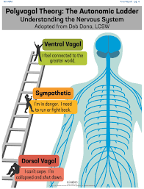
Polyvagal Theory (Porges)
3 Stages: Social Engagement, Fight/Flight, Freeze.
We must first move out of freeze with some fight/flight energy (“healthy aggression”) then into social engagement.

Slide 13
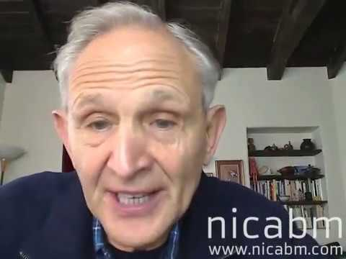
1rst Goal with Clients: Feeling Safe Again
Notes:
https://www.youtube.com/watch?v=1ZpZvxhk8Ew&t=65s

Slide 14
12 Somatic Exercises

Slide 15
12 Exercises for Healing Trauma
Safety & Containment Exercises - Reducing Dissociation
Grounding & Centering
Building Resources
Tracking Sensations
Tracking Activation
Pendulation
Fight Response: Natural Aggression Vs. Violence
Natural Escape Vs. Anxiety
Strength and Resilience Vs. Collapse
Uncoupling Response
Reorienting
Settling and Orienting

Slide 16
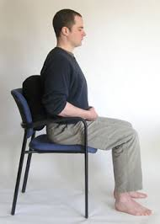
Phase 1: Safety & Containment Exercises I- Reducing Dissociation
Notice back of chair (vague or strong) where you’re sitting
Feel back of chair and energy from ground supporting you.

Slide 17
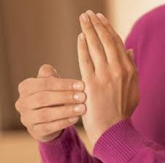
Safety & Containment Exercises II
Tap palm of left hand with fingers of right hand
What do you feel?
Say “This is my hand and belongs to me”.
Tap other parts of body

Slide 18
Shower
Have the client do the same exercise in the shower.
Direct the showerhead towards different parts of the body.

Slide 19
Safety & Containment Exercises III
Squeeze your left tricep muscle
Say: “This is my muscle and is part of me. It helps me lift my arms”.
Repeat with different body parts.

Slide 20
Safety & Containment Exercises IV
Take a yarn or string and seat yourself on the floor.
Notice your body and boundaries
Place the string to delineate boundary
Assert this boundary when needed

Slide 21
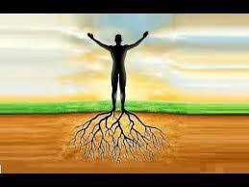
Phase 2: Grounding & Centering
Stand on your feet noticing the springiness/stiffness in legs.
Sway from ankles back/forth & forward/back.
Locate center in lower belly and place your hands there.

Slide 22
Phase 3: Building Resources
External:
Nature
Family
Friends
Music
Sports etc

Slide 23
Building Resources
Internal:
Strength
Agility
Creativity
Intelligence
Spiritual practice

Slide 24
Building Resources
Build a list of resources with client:
Internal External

Slide 25
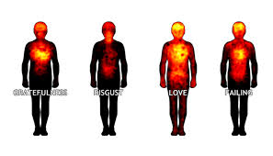
Phase 4: Tracking Sensations
Describe bodily sensations:
Nervous
Numb
Tight
Achy
Dizzy
Floating
Cold
Hot
Constricted
Sweaty
Expanded
Disconnected

Slide 26
Phase 4
Pick a safe object
Shift focus from object to sensations in the body
Explore nuances
Pendulate between image and bodily sensations.

Slide 27
Phase 5: Tracking Activation
Recall recent unpleasant memory (light one ie missing the bus, losing your keys, temper etc):
If thought arises say:
“I just had a thought. What do I
begin to notice in my body?”

Slide 28
Phase 5: Tracking Activation
Negative thought tightens body.
Notice how body intensifies the thoughts as well.

Slide 29
Let the sensation expand and contract.
Try to focus only on sensation and not feelings or thoughts.
When you’re able to separate sensations from emotions it will be less stuck in habitual traumatic patterning.

Slide 30
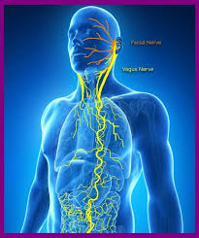
Vagus Nerve
10th cranial nerve is responsible for the regulation of internal organ functions, such as digestion, heart rate, and respiratory rate, as well as vasomotor activity.
Stimulates muscle contractions in the parasympathetic nervous system and helps relaxation.

Slide 31
Vagus Nerve
Breathe more slowly (aim for 5-6 breaths per minute).
Exhale longer than you inhale. It’s the exhale that triggers the relaxation response.
Gargling with water or loud singing
Cold water face immersion

Slide 32
Voooo Sound Exercise
Stimulates the Vagus nerve
Sends positive information upwards.
Moves from “eh” to “aah”.

Slide 33
Voooo Sound Exercise

Slide 34
Rabbi Avraham Abulafia
“In the case of shuruk (with the sound of “oo”), neither raise nor lower your head, but push it forwards at a middle level.”
Ohr Hasechel

Slide 35
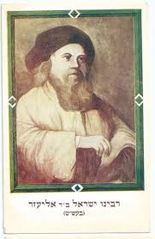
Baal Shemtov
Inhale and think about the word “Barooch”.
Exhale and say “Barooooooch”.

Slide 36
Phase 6 -
Regulation/Pendulation/Titration
Regulation restores the rhythm of life.
Helps a person become aware of their body and learn the skill to gently pendulate out of the sensation.

Slide 37
Phase 6 -
Regulation/Pendulation/Titration
Empowers the client to re-experience their body and have a sense of control over their embodied state.
“I am safe to explore my sensations and notice them calming down.”

Slide 38
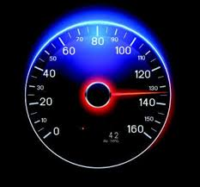
Phase 6 - Regulation
Zone of regulation (out of dissociation - collapse/rage)
Stopping Dramatizing (80 mph) or Intellectualizing (20 mph)
Take your SUDS level (Subjective Units of Discomfort)

Slide 39
SUDS

Slide 40
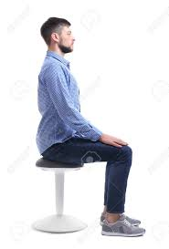
Phase 6 - Regulation
Feel your feet touching the ground
Notice the chair your sitting on and holding your back
Notice your breathing
May take a minute or so

Slide 41
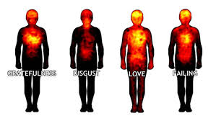
Phase 6 - Pendulation/Titration
Think of a (sliver) of a difficult memory or image and notice the sensation in the body.
Go back to grounding (feet, seat, breath).
Now, stay with it and watch it contract and expand.

Slide 42
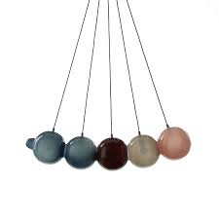
Phase 6 - Pendulation 2
Notice an object in front of you. Focus on a calming aspect of it. (Find that within you.)
Pendulate back-and-forth between the calming object (grounding sensation) and your tension.
Focus mainly on sensation and not on thoughts.

Slide 43
Phase 6 - Pendulation
Just track sensation for some time (minutes) and allow a discharge to take place.
Reassure client that the nervous system naturally contracts/expands and that these sensations are the body’s way of gently moving out of freeze.

Slide 44
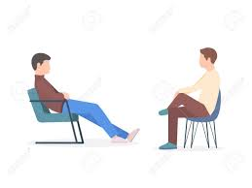
Exercise
Break up in pairs and facilitate the grounding and pendulation phase. Up to 5 minutes per person.
Use words like: notice, feel, gently move back and forth, yes, good, explore etc.
Notice was you feel as facilitator and participant.

Slide 45
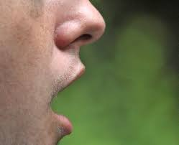
Create Expansion/Contraction
Ask the client to gently open and closet the mouth to release more energy and flow
This can also be done by opening and closing the hands

