Slide 1
Viktor Frankl Marriage & Intimacy
Coaching With Rabbi Daniel Schonbuch, LMFT
Week 5

Slide 2
First Session
Contact Information
Today’s Date:
Full names:
Address:
Phone:
Email:
Personal information
Dates of birth:
Emergency contact number:
Notes:
https://www.youtube.com/watch?v=-4EDhdAHrOg

Slide 3
First Session
Family members:
Medical issues:
Trauma:
Addictions:
Medications:
Previous therapy/coaching?
Other:
Primary focus:
Wife:
Husband:
Notes:
https://www.youtube.com/watch?v=-4EDhdAHrOg

Slide 4
Primary Focus/Concerns
Please identify one area of focus for marriage coaching:
Examples:
Enjoy spending time together
“I would like to develop a better relationship with my spouse and spend more time together”
Too much fighting
“We find ourselves fighting too much each day about trivial matters.”
Notes:
https://www.youtube.com/watch?v=-4EDhdAHrOg

Slide 5
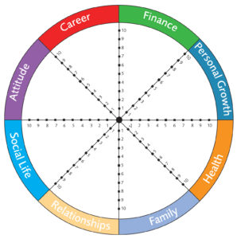
Quality Time
WHEEL OF LIFE
Spirituality
Intimacy
Notes:
https://www.youtube.com/watch?v=-4EDhdAHrOg

Slide 6
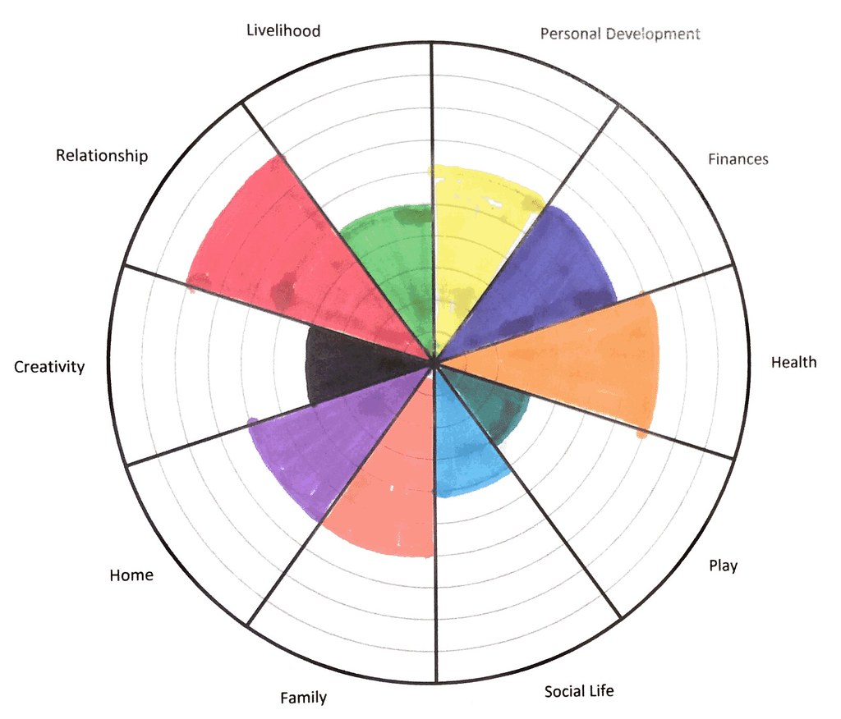
WHEEL OF LIFE
FILLED OUT
Notes:
https://www.youtube.com/watch?v=-4EDhdAHrOg

Slide 7
Powergram
Notes:
https://www.youtube.com/watch?v=-4EDhdAHrOg

Slide 8
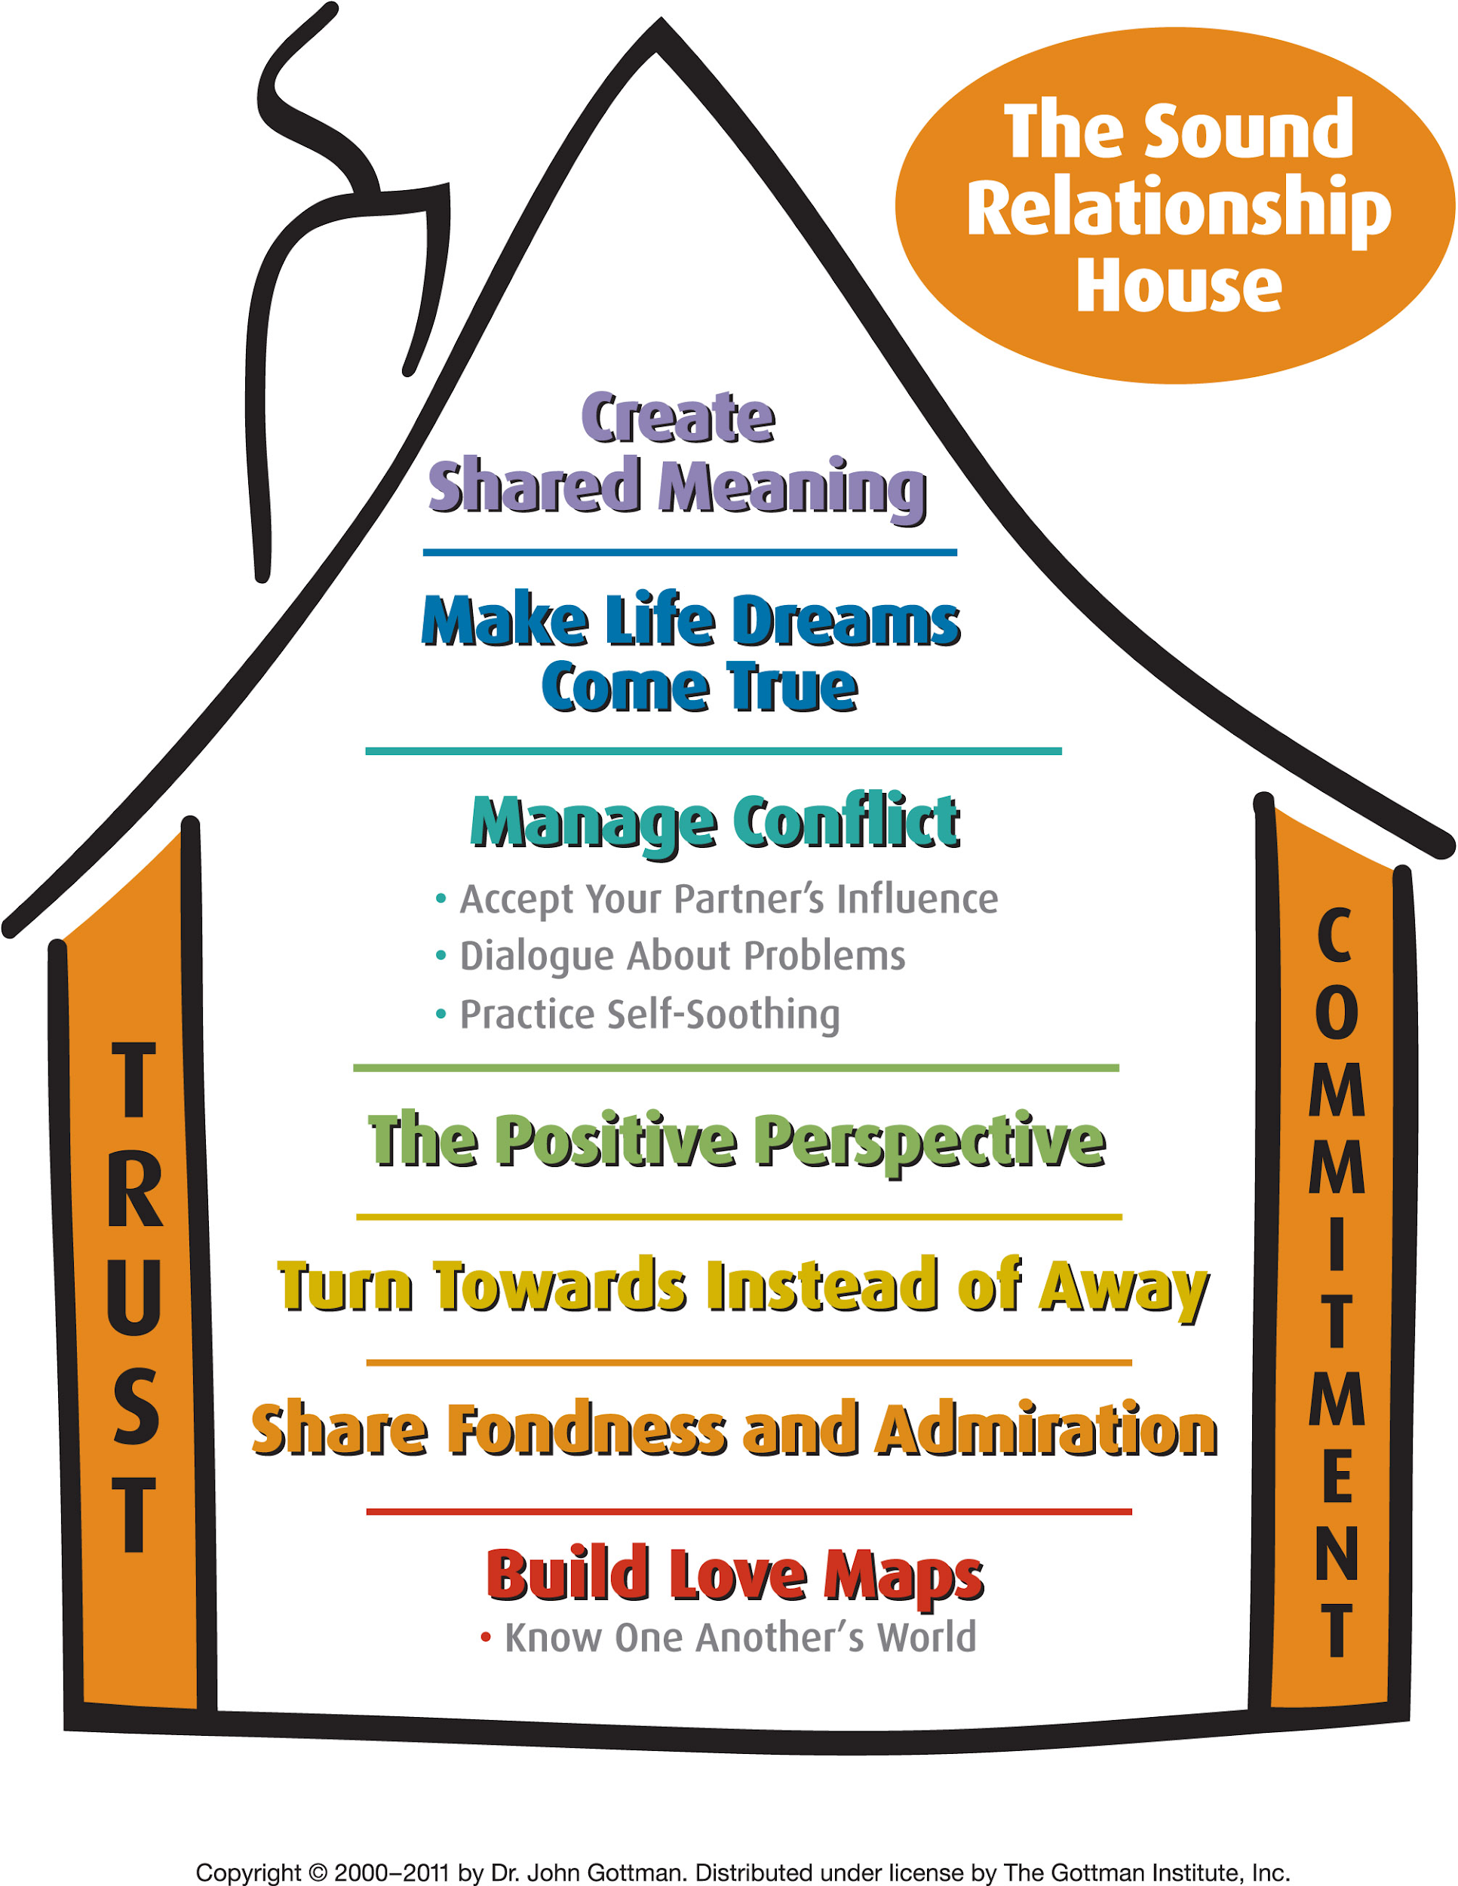
Introduce Gottman’s Principles and Sound Relationship House
Notes:
https://www.youtube.com/watch?v=-4EDhdAHrOg

Slide 9
The History of The Relationship
Let’s discuss how the two of you met and got together. Was there anything about your partner that made him or her stand out? What were your first impressions?
What do you remember most about the time you were first dating? What stands out? How long did you know each other before you got engaged (married). What do you remember about this period? What were some of the highlights? Some of the tensions? What type of things did you do together?
Notes:
https://www.youtube.com/watch?v=AKTyPgwfPgg until 844

Slide 10
The History of The Relationship
What do you remember about the first year you were married? Were there any adjustments you needed to make?
What about the transition to becoming parents? Talk to each other about this period of your marriage. What was it like for the two of you?
Looking back over the years, what moments stand out as the really happy times in your marriage? What is a good time for you as a couple? Has this changed over the years?
Notes:
https://www.youtube.com/watch?v=AKTyPgwfPgg until 844

Slide 11
The History of The Relationship
Why do you think some marriages work while others don’t?
How would you compare your relationship to each of these couples?
Talk about your parents’ marriage. Would you say they were very similar to or different from your thoughts on what a marriage should be?
What were the happiest times for you? For your partner? How has your marriage changed over the years?
Notes:
https://www.youtube.com/watch?v=AKTyPgwfPgg until 844

Slide 12
First Session Discussion
Recent Important Events (What has occurred recently that is important?)
Upcoming Events (what is it you looking forward to?)
Current stresses (what are some current stresses in your life?)
Current worries (are you worried about?)
Hopes and aspirations (for self? For others?)
Notes:
https://www.youtube.com/watch?v=-4EDhdAHrOg

Slide 13
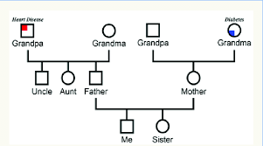
GENOGRAM
Notes:
https://www.youtube.com/watch?v=-4EDhdAHrOg

Slide 14
Goals and Commitments
A commitment is a quality of life shift i.e. “We want to spend more time together” or “We want to improve our intimacy”. A goal is a specific activity or process you want to complete which is measurable i.e. “We will take a vacation every 6 months” or “We will go to bed together 2 x this week”.
Goals Commitments
_____________________________________________
Notes:
https://www.youtube.com/watch?v=iTrK06Z_JxE 521
https://www.youtube.com/watch?v=iTrK06Z_JxE

Slide 15
Completion Log
Item to Complete Do By Done
Notes:
https://www.youtube.com/watch?v=-4EDhdAHrOg

Slide 16
How to time a session
Notes:
Week 3 coaching

Slide 17
Suggest homework exercises based on discussions, goals and commitments.
Suggest they buy “7 Principles”
Review the importance of PSO and affectionate behavior.
Ask if they have any further questions
Closing Session with Homework

Slide 18
SUMMARY
Enhancing love maps
Nurturing fondness and admiration
Turning toward each other
Accepting influence
Solving solvable problems
Overcoming gridlock
Creating shared meaning

Slide 19
SUMMARY
Enhancing love maps
Nurturing fondness and admiration
Turning toward each other
Accepting influence
Solving solvable problems
Overcoming gridlock
Creating shared meaning

