Slide 1
Viktor Frankl Marriage, Dating
& Intimacy Coaching
With Rabbi Daniel Schonbuch, LMFT
Week 2

Slide 2
MARRIAGE & FAMILY THERAPY
Theories on Dysfunction/Resilience
Murray Bowen/ Monica McGoldrick
Pia Mellody - Codependence
Pursue/Withdraw
Domestic Violence

Slide 3
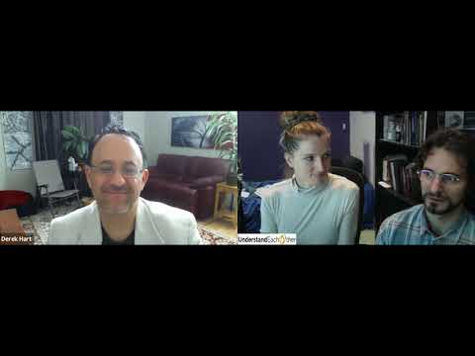
EASY MARRIAGE COACHING SESSION
Notes:
https://www.youtube.com/watch?v=13rAkY6KYjg

Slide 4
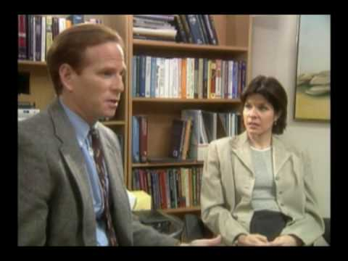
MODERATE MARRIAGE COACHING SESSION
Notes:
https://www.youtube.com/watch?v=o3A24umyTK4

Slide 5
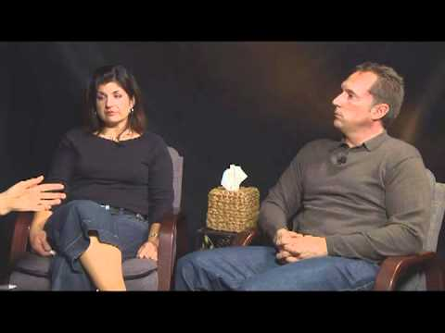
DIFFICULT MARRIAGE COACHING SESSION
Notes:
https://www.youtube.com/watch?v=13rAkY6KYjg

Slide 6
LEVELS OF COACHING/THERAPY
BEHAVIORAL
EMOTIONAL
COGNITIVE
TRAUMATIC
CHILDHOOD
Notes:
https://www.youtube.com/watch?v=-4EDhdAHrOg

Slide 7
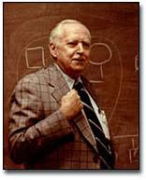
Dr. Murray
Bowen
Genogram
Multigenerational Transmission Process
Emotional Cutoff/ Enmeshment vs Balance
Triangulation

Slide 8
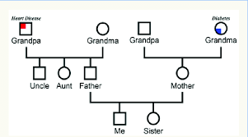
GENOGRAM
Notes:
https://www.youtube.com/watch?v=-4EDhdAHrOg

Slide 9
GENOGRAM
Notes:
https://www.youtube.com/watch?v=-4EDhdAHrOg

Slide 10
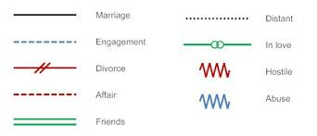
GENOGRAM
Notes:
https://www.youtube.com/watch?v=-4EDhdAHrOg

Slide 11
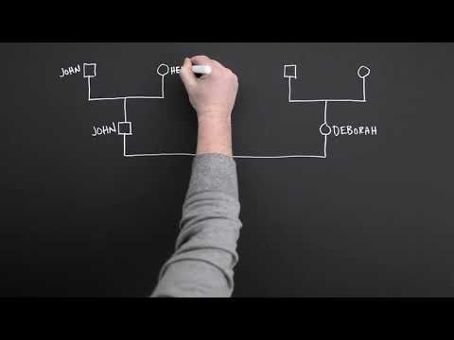
MAKING A GENOGRAM
Notes:
https://www.youtube.com/watch?v=Zn_jfTImacM

Slide 12
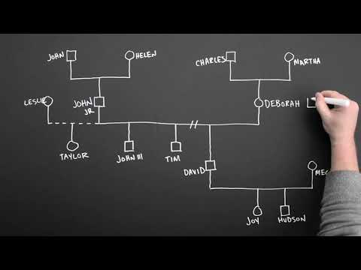
MAKING A GENOGRAM
Notes:
https://www.youtube.com/watch?v=ka6vHP_cczs

Slide 13
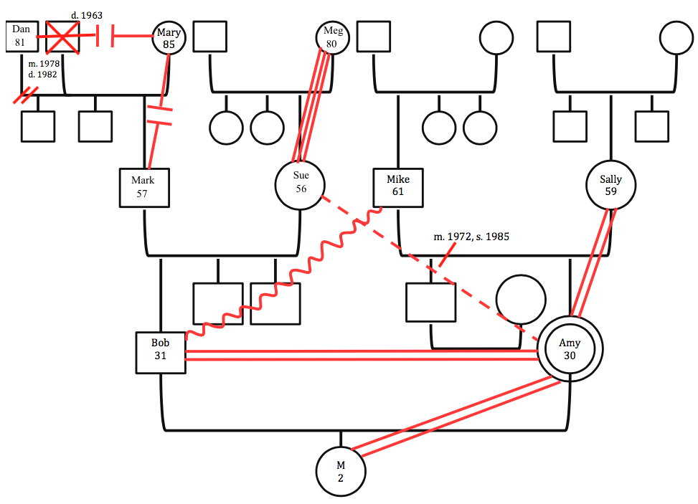
ALBERT EINSTEIN
Notes:
https://www.youtube.com/watch?v=-4EDhdAHrOg

Slide 14
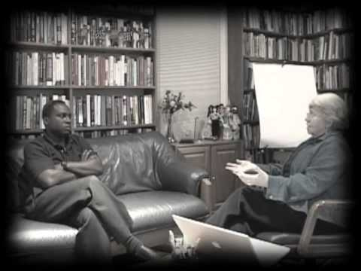
MONICA MCGOLDRICK
Notes:
https://www.youtube.com/watch?v=T0MXxGH33Lo&t=1s

Slide 15
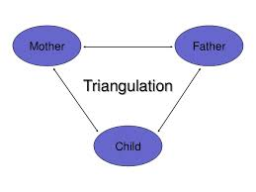

Slide 16
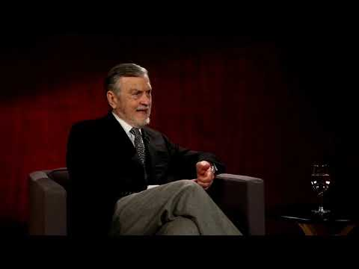
FINDING YOUR IMAGO
Notes:
https://www.youtube.com/watch?v=T0MXxGH33Lo&t=1s

Slide 17
FINDING YOUR IMAGO
Notes:
https://www.youtube.com/watch?v=T0MXxGH33Lo&t=1s

Slide 18
PIA MELLODY -
CODEPENDENCE
Emerges from AA
Overcoming neglectful/abusive childhood

Slide 20
Notes:
https://www.youtube.com/watch?v=-4EDhdAHrOg

Slide 21
Notes:
https://www.youtube.com/watch?v=-4EDhdAHrOg

Slide 22
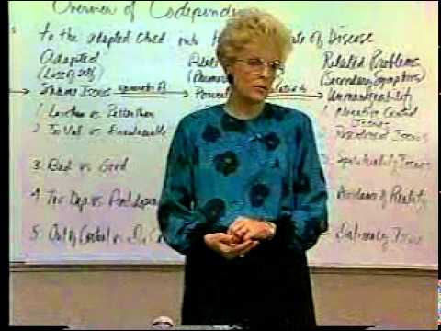
Notes:
https://www.youtube.com/watch?v=nrLaaar02e4

Slide 23
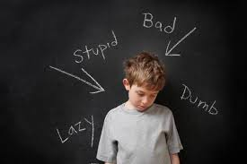
FAMILY OF ORIGIN
QUESTIONNAIRE
If you notice early childhood trauma, have client fill out form for next session.
Download at www.torahpsychology.org/marriageresources6

Slide 24
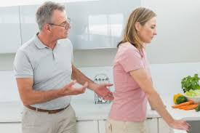
PURSUE/WITHDRAW

Slide 25
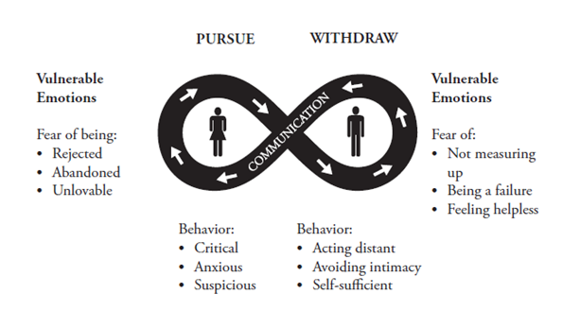
PURSUE/WITHDRAW LOOP
Notes:
https://www.youtube.com/watch?v=iTrK06Z_JxE 521
https://www.youtube.com/watch?v=iTrK06Z_JxE

Slide 26
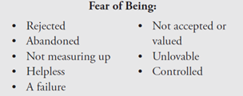
FEARS

Slide 27
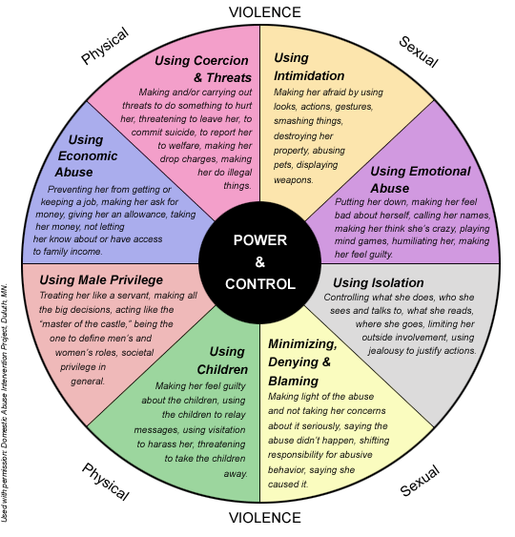
DOMESTIC
VIOLENCE

Slide 28
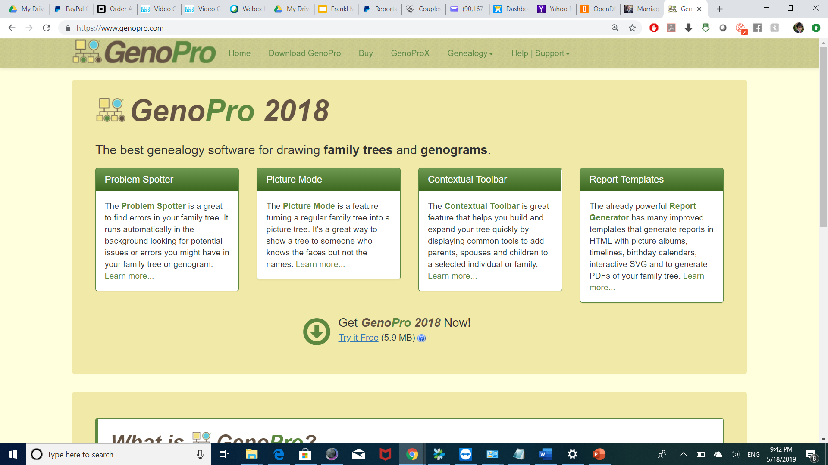
HOMEWORK
HOMEWORK

