Slide 1
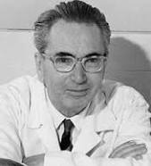
Think Good/
Viktor Frankl Coaching Program
Week 15
With Rabbi Daniel Schonbuch,
LMFT
Notes:
he focus of coaching is the coaching client relationship.
People participate in coaching because I want things to be different. And looking for change or they have important goals. They may be motivated to cheat specific goals to write a book start a business for the help of a healthier body.
Sometimes people just want more peace of mind less confusion and less financial pressures. All of this begins with during Kochi towards motivation
One of the focuses of this program will be the 1coactive coaching model.
There are 4/4 cornerstone.
People are naturally creative in capable of finding answers
Focus on the whole person that means they are thoughts feelings and actions relationships in their body
Dance in the moment. Every moment is an opportunity to listen or deeply and to create a new tone mood for this means we have to be able to dance with the client to follow your lead.
Evoke transformation.
The coach is able to take the entire person of him and with the coach he hold two and model of the vision that they want to achieve. The key here however is to look for the connection between igniting today's goals in life potential visit. This is what we call transformation. It moves a person from the satisfaction of ahh to breakthrough awareness of aha finding a new strength for covering a renewed capacity. It's like finding a muscle didn't know you had or had forgotten. This brings towards a deeper awareness that the coach he has an expanded capacity to reach his or her capacity potential. Another words provoking transformation means that the coach plays eight dynamic role of holding the vision of what is possible

Slide 2
Week 15
Your professional development plan
Let’s review coaching
Viktor Frankl on Fulfilling Meaning
Group discussion Graduation Ceremony

Slide 3
Let’s Review Coaching
What are the key coaching principles?
What is the co-active model?
How do people change?

Slide 4
7 Top Coaching Principles
The Coaching Spirit/ Coactive Model
Relationship and Trust
Asking Questions and Curiosity
Listening and Intuition
Feedback and Awareness
Goals and Action Plans
Accountability and Accomplishments
Notes:
The Coaching Spirit
Believe in Human Potential for Greatness
Fulfillment Flows from Adding Value to Others
Bring Out the Best in People and Let Them Lead
Use Influence Rather than Position
Thrive on Challenges and Flexibility
When We Grow Others, We Grow Ourselves
A Coach Still Needs a Coach
Relationship and Trust
Maintain Authentic Rapport and Humor
Touch a Heart with Care and Sincerity
Practice Integrity and Build Trust
Asking Questions and Curiosity
Curiosity Ignites Your Spirit
Ask Questions that Empower and Create Buy-In
Avoid Judgmental and Advice-Oriented Questions
Powerful Questions Release Solutions
Asking Great Questions Requires Practice
Listening and Intuition
Listen Rather Than Tell
Be Present and Turn Off Your Inner Dialogue
Avoid Jumping to Premature Conclusions
Be Impartial and Nonjudgmental
Listen Deeply, Use Observation and Intuition
Tip: Click here to learn how to meditate for clarity, intuition and mindfulness.
Feedback and Awareness
Embrace Feedback to Triumph
Awareness and Acceptance Cultivates Transformation
Suggestions and Simplification
Get Consent Before Giving Suggestions
Use the Power of Simplicity
Study the habits of successful people
Goals and Action Plans
Establish Goal Ownership and Commitment
Create Strategies and Action Plans for Goals
Keep Score of Goals and Action Steps
Use visualization techniques to maintain focus and to leverage the Law of Attraction
Accountability and Accomplishments
Support Goals Completion Continuously
Accountability Drives Accomplishments
Acknowledge Efforts and Progress

Slide 5
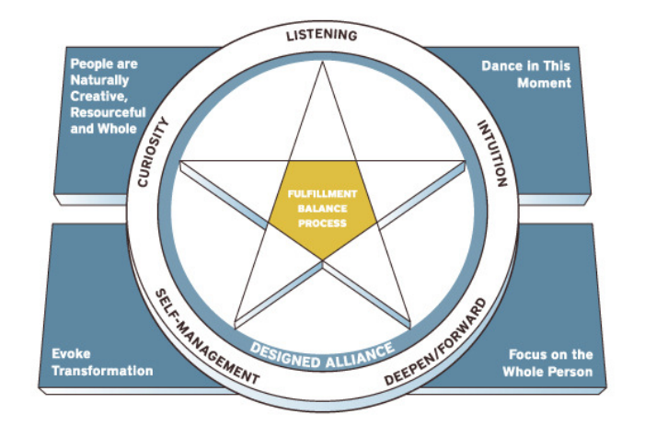
Coactive Model

Slide 6
Helping People Fulfill a Meaning

Slide 7
Sharing about your experience
on the program
What did you learn?
How have you changed?
What do you want to do now with the new information?

Slide 8
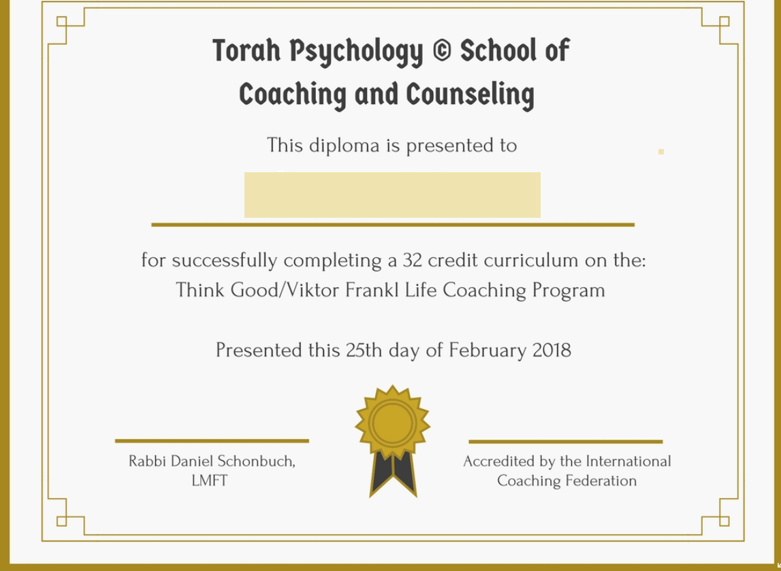
Graduation Ceremony
Congratulations! Roll Call.

