Slide 1
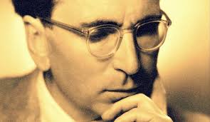
The Neuroscience of Trauma & Movement
2
Viktor Frankl Mind/Body & Soul
Trauma-Healing
Life Coaching Program Week 9

Slide 2
The Sarno Method
9

Slide 3
Dr Sarno
Mind/Body Connection with Pain
TMS

Slide 4
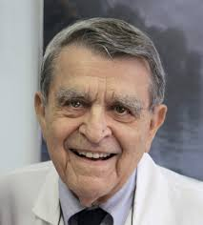
TMS-Tension Myositis (Myoneural) Syndrome Mind Body Syndrome (MBS)
At Rusk Institute of Rehabilitation Medicine in New York, Dr Sarno saw many cases where his patients didn’t respond as he expected to the conventional treatments.
He noticed that in addition to their complaints (mainly back, neck and shoulder issues), his patients often shared a common pattern of underlying tension.

Slide 5
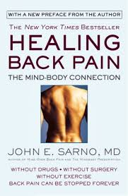
In Healing Back Pain Dr Sarno introduces the concept of Tension Myositis Syndrome (TMS).
Mind Body Syndrome
Sarno defined TMS as “a change of state in the muscle that is painful”

Slide 6
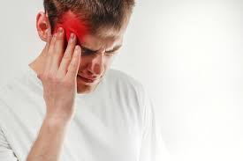
TMS can manifest in so many different ways:
Headaches
Migraines
Pelvic pain
IBS
Chronic fatigue
Fibromyalgia
Carpal tunnel syndrome and repetitive strain syndromes (RSI)

Slide 7
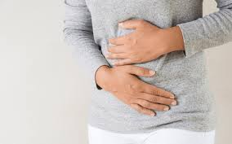
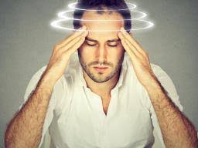
TMJ
Vertigo
Dizziness
Insomnia, anxiety, depression, phobias and disorders

Slide 8
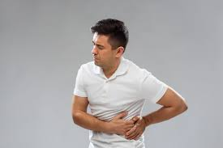
Rule it Out
First rule out with a physician
Do not treat this alone

Slide 9
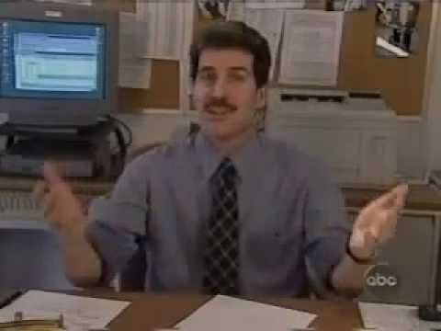
Is Back Pain a Mental Problem?
Notes:
https://www.youtube.com/watch?v=vsR4wydiIBI&t=1s

Slide 10
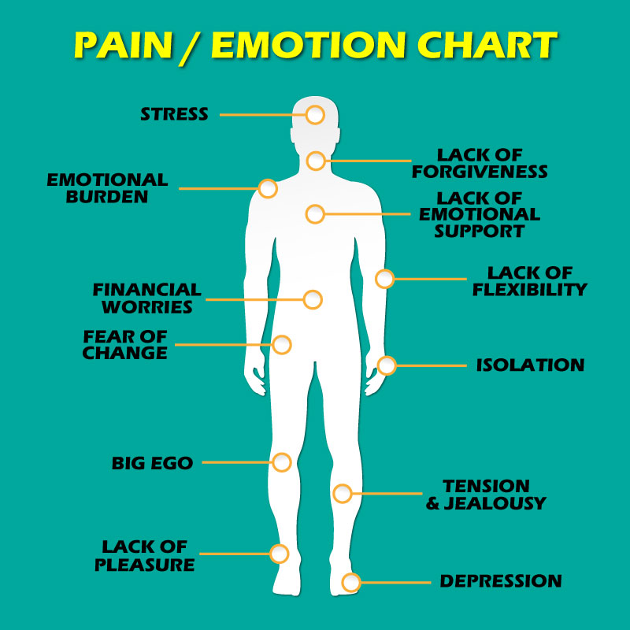
1: It’s more than ‘just’ physical
Physical pain doesn’t necessarily have (only) physical causes.
Emotional pain could and does manifest as a variety of physical symptoms.

Slide 11
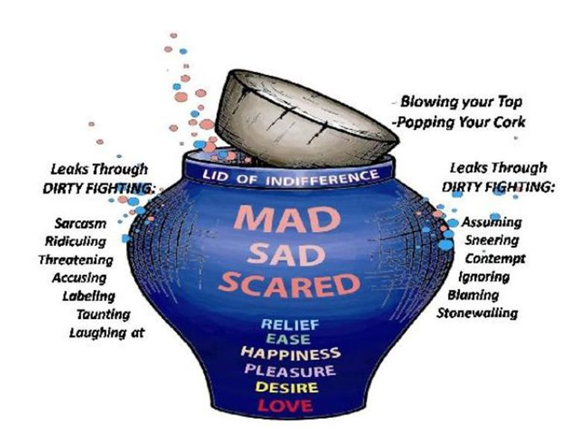
2: Squashed, stuffed, buried, ignored and repressed emotions
Tendency is to repress unpleasant, painful or embarrassing emotions.
When we repress these emotions, our bodies respond to the real and perceived threats

Slide 13
3: The role of oxygen deprivation
The autonomic nervous system activates our fight, flight or freeze response.
The oxygen in our blood supply becomes limited to our muscles, nerves, tendons and ligaments.

Slide 14
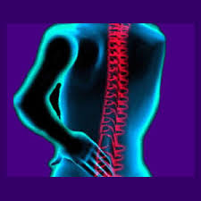
Oxygen deprivation means we experience tension, dysfunction and physical pain.
Repressed, ignored and/or unresolved emotions can cause physical pain.

Slide 15
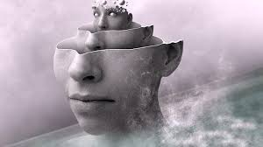
4: The unconscious mind: a complicating factor
We aren’t even aware that we’re repressing our emotions.
Controlling, hiding from and/or ignoring our emotions and we don’t even realize we have emotions.

Slide 16
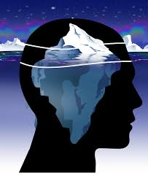
As Dr Sarno explains:
“The overwhelming majority of emotional and mental activity occurs below the level of consciousness.
The human mind is something like an iceberg. The part that we are aware of, the conscious mind, represents a very small part of the total. It is in the subconscious mind that all of the complicated processing goes on…
… This condition begins and ends in the unconscious.”

Slide 17
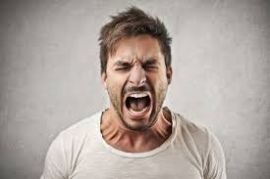
5: The power of distraction
Conflict between conscious and unconscious. Pain purposefully works to distract you from figuring out what’s going on in your emotional world.
Pain has the ability “to really grab one’s attention, particularly if they are painful, frightening and disabling”.

Slide 18
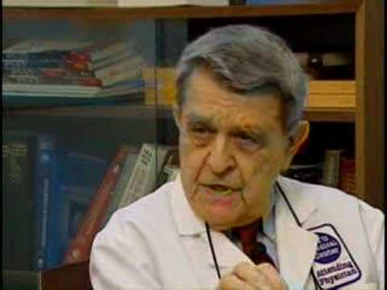
Is Back Pain a Mental Problem?
Notes:
https://youtu.be/gcN8NRr_0sk

Slide 19
Rational Thoughts
Raw Emotions
Instinctual Sensations

Slide 20
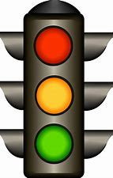
FEAR (Levine)
CONTROL(Glasser)
ANGER (Sarno)
Rational Thoughts
Raw Emotions
Instinctual Sensations

Slide 21
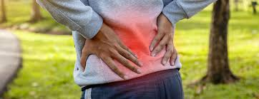
Conscious (“Don’t feel rage”)
Unconscious (“Feel rage”)
PAIN

Slide 22
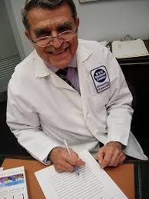
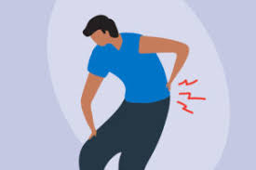
Pain is a defense mechanism against unconscious mental stress and emotions such as:
Anxiety
Narcissistic rage

Slide 23
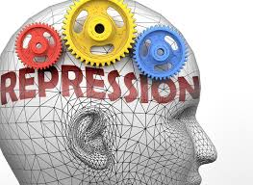
The conscious mind is distracted by the physical pain.
The psychological repression process keeps the anger/rage contained in the unconscious and thereby prevented from entering conscious awareness.

Slide 24
Personality Types & Pain
Perfectionists
Goodists

Slide 25
Perfectionists
Strong desire to have everything they do be perfect.
Tend to put too much on their plate at once and try to accomplish too many things.
Ignore their own needs and repress their feelings.

Slide 26
Goodism/People Pleasing
Put the needs and desires of others before their own.
Have a strong need for other people to like them.
Routinely change their plans to help out others.

Slide 27
Goodism/People Pleasing
Fail to address their own needs, repressing their emotions, desires and feelings.
Deep-seated feelings of inadequacy and low self-worth.
Infuriates the unconscious mind, causing it to act out by creating TMS symptoms.

Slide 28
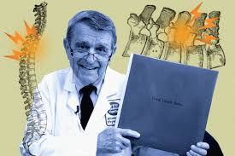
Sarno Method Lecture
Repudiate structural explanation
Attribute to TMS
Think psychological, not physical

Slide 29
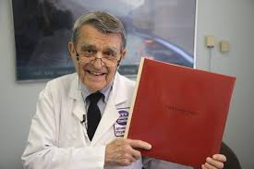
The Sarno Method
List out all issues that might contribute to the patient's repressed emotions::
(a) certain childhood experiences, such as abuse or lack of love,
(b) personality traits such as perfectionism, conscientiousness and a strong need to be liked, approved or validated by everyone.

Slide 30
The Sarno Method
(c) current life stresses and pressures,
(d) aging and mortality and
(e) situations in which the patient experiences conscious but unexpressed anger.
Write down answers in detail.

Slide 31
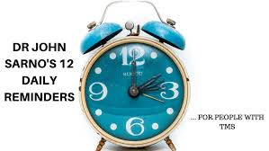
Sarno’s 12 Daily Reminders
The pain is due to TMS, not to a structural abnormality
The direct reason for the pain is mild oxygen deprivation
TMS is a harmless condition caused by my repressed emotions
The principal emotion is my repressed ANGER

Slide 32
Sarno’s 12 Daily Reminders
5. TMS exists only to distract my attention from the emotions.
6. Since my back (replace with whatever pain you’ve got) is basically normal there is nothing to fear.
7. Therefore, physical activity is not dangerous.
8. And I MUST resume all normal physical activity.

Slide 33
Sarno’s 12 Daily Reminders
9. I will not be concerned or intimidated by the pain.
10. I will shift my attention from pain to the emotional issues.
11. I intend to be in control-NOT my subconscious mind.
12. I must think Psychological at all times, NOT physical.

Slide 34
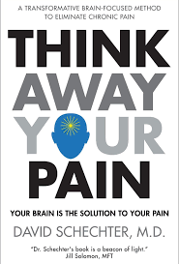
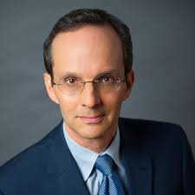
David Schechter MD

Slide 38
David Schechter MD
Patient must first visit physician to rule out other conditions.
Personality Type

Slide 39
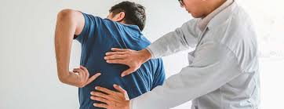
Personality Type
Type T personality type. T is for Tension
M motivated, achiever
N nice, a goodist, driven to perform good acts
O prefers order

Slide 40
Personality Type
P perfectionist, a people pleaser
Q quick to judge
R responsible
S self-critical
T Type T

Slide 41
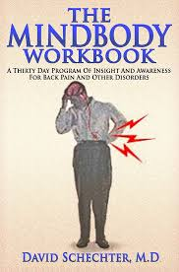
30-Day Workbook
The MindBody Workbook assists the patient in recording emotionally significant events.
Makes correlations between those events and their physical symptoms.

Slide 42
David Schechter MD, Workbook
What went on in your life today?
What connection between these emotions and your symptoms did you notice?
What physical activities have you done today?

Slide 43
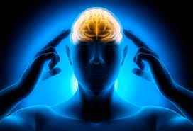
David Schechter MD, Workbook
4. Have you had any time for yourself today?
5. What did you do for fun today?
6. What was your family’s way of dealing with anger?

Slide 44
Trauma Journal 6
Explore pain in your body
Journal about your emotions connected to pain.
Do so for 30 days and monitor changes

