Slide 1
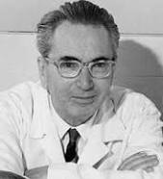
Viktor Frankl Transformational Life Coaching Program
Week 13
With Rabbi Daniel Schonbuch,
LMFT
Notes:
he focus of coaching is the coaching client relationship.
People participate in coaching because I want things to be different. And looking for change or they have important goals. They may be motivated to cheat specific goals to write a book start a business for the help of a healthier body.
Sometimes people just want more peace of mind less confusion and less financial pressures. All of this begins with during Kochi towards motivation
One of the focuses of this program will be the 1coactive coaching model.
There are 4/4 cornerstone.
People are naturally creative in capable of finding answers
Focus on the whole person that means they are thoughts feelings and actions relationships in their body
Dance in the moment. Every moment is an opportunity to listen or deeply and to create a new tone mood for this means we have to be able to dance with the client to follow your lead.
Evoke transformation.
The coach is able to take the entire person of him and with the coach he hold two and model of the vision that they want to achieve. The key here however is to look for the connection between igniting today's goals in life potential visit. This is what we call transformation. It moves a person from the satisfaction of ahh to breakthrough awareness of aha finding a new strength for covering a renewed capacity. It's like finding a muscle didn't know you had or had forgotten. This brings towards a deeper awareness that the coach he has an expanded capacity to reach his or her capacity potential. Another words provoking transformation means that the coach plays eight dynamic role of holding the vision of what is possible

Slide 2
Week 13
Building Your Practice
Finding Your Niche
Resume
Web design
Blog/Articles
Facebook, Linkedin, Instagram
Lectures
Portfolio

Slide 3
Finding Your Niche

Slide 4
Teens at Risk
Marriage
Business
Wellness

Slide 5
Tell a Story
Obesity
Avi Fishoff - Home Sweet Home
Mort Fertel - Marriage Max .com
Chaya Abelsky - Infiniti Coaching
Nutrition by Tanya

Slide 6
Avi Fishoff
Notes:
https://www.youtube.com/watch?v=FwDm_9yb25E

Slide 7
Notes:
https://www.youtube.com/watch?v=3H6bhV5_Cug

Slide 8
Tanya
https://nutritionbytanya.com/tanyas-story/
Notes:
https://www.youtube.com/watch?v=KUTuV-cT5DE

Slide 9
Resume
List your accomplishments
Skills
Talents
Passions

Slide 10
How can I help you?
I can…...
Help you get healthier
Lose weight
Improve your marriage
Connect with your teen
Save money
Make more money
Choose a spouse

Slide 11
State your Principles
I work by:
Focusing on solutions, not problems
Listening deeply
Being non-critical
Focusing on your strengths
Helping you be accountable/chart your success

Slide 12
Help Set Goals
Comprehensive intake
Goal and vision setting
SMART
Charting success
Overcoming obstacle

Slide 13
Articles and Promo
RIFKA SCHONFELD
Hamodia columnist "The Social Circle"
Jewish Press columnist "Mind and Manners"
Yated columnist "Socially Speaking"
Author of Children’s book, My Friend, the Bully.
Writer in Binah and other publications
http://www.rifkaschonfeldsos.com/index.html

Slide 14
Baseline

Slide 15
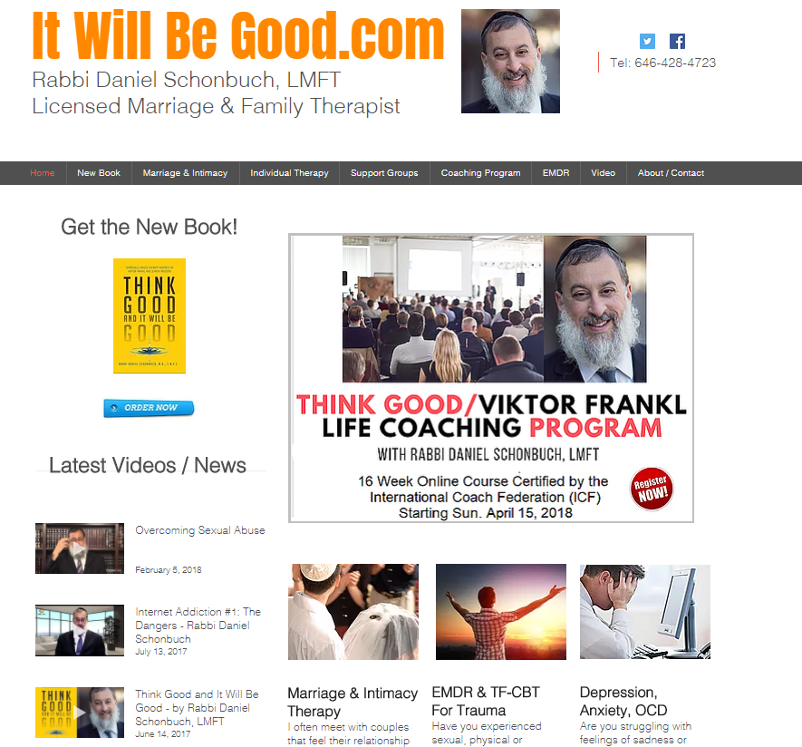

Slide 17
Jewish Press
Collive.com
TheYeshivaworld.com
Ami
Mishpacha

Slide 21
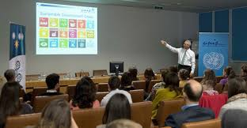
Free Lectures
Synagogues
Nshei
Board rooms
Parents’/Couples’ Groups in homes

Slide 22
Powerpoint

Slide 23
Carl Jung

Slide 24
Practice Time
10 Minutes each person

Slide 25
Wellness Coaching Today

