Slide 1
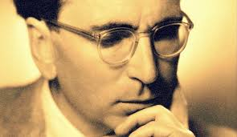
The Neuroscience of Trauma & Movement
2
Viktor Frankl Mind/Body & Soul
Trauma-Healing
Life Coaching Program Week 4

Slide 2
Somatic Coaching II
4

Slide 3
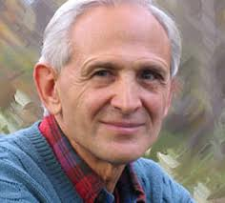
Week 4
SIBAM
Pendulation
Discharging Activation
Natural Escape vs. Anxiety
Resilience vs. Collapse
- Sensorimotor Coaching
Over-coupling
Reorienting
Settling and Integrating

Slide 4
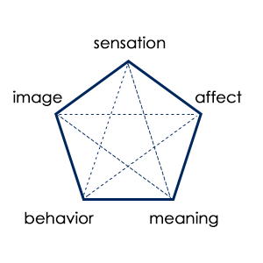
SIBAM
Notes:
https://www.youtube.com/watch?v=LiXOMLoDm68

Slide 5
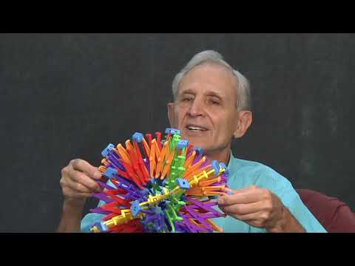
Phase 6 - Pendulation
Notes:
https://www.youtube.com/watch?v=LiXOMLoDm68

Slide 6
Phase 6 -
Regulation/Pendulation/Titration
Regulation restores the rhythm of life.
Helps a person become aware of their body and learn the skill to gently pendulate out of the sensation.

Slide 7
Phase 6 -
Regulation/Pendulation/Titration
Empowers the client to re-experience their body and have a sense of control over their embodied state.
“I am safe to explore my sensations and notice them calming down.”

Slide 8
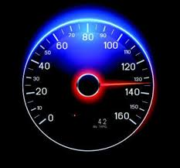
Phase 6 - Regulation
Zone of regulation (out of dissociation - collapse/rage)
Stopping Dramatizing (80 mph) or Intellectualizing (20 mph)
Take your SUDS level (Subjective Units of Discomfort)

Slide 9
SUDS

Slide 10
Phase 6 - Regulation
Feel your feet touching the ground
Notice the chair your sitting on and holding your back
Notice your breathing
May take a minute or so

Slide 11
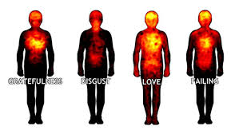
Phase 6 - Pendulation/Titration
Think of a (sliver) of a difficult memory or image and notice the sensation in the body.
Go back to grounding (feet, seat, breath).
Now, stay with it and watch it contract and expand.

Slide 12
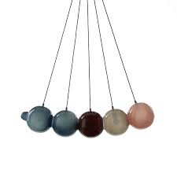
Phase 6 - Pendulation 2
Notice an object in front of you. Focus on a calming aspect of it. (Find that within you.)
Pendulate back-and-forth between the calming object (grounding sensation) and your tension.
Focus mainly on sensation and not on thoughts.

Slide 13
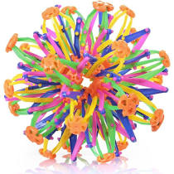
Phase 6 - Pendulation
Just track sensation for some time (minutes) and allow a discharge to take place.
Reassure client that the nervous system naturally contracts/expands and that these sensations are the body’s way of gently moving out of freeze.

Slide 14
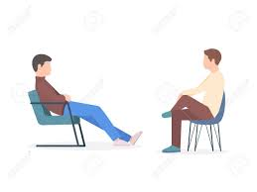
Exercise
Break up in pairs and facilitate the grounding and pendulation phase. Up to 5 minutes per person.
Use words like: notice, feel, gently move back and forth, yes, good, explore etc.
Notice what you feel as facilitator and participant.

Slide 15
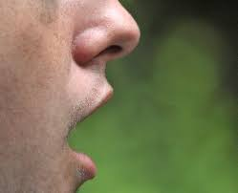
Create Expansion/Contraction
Ask the client to gently open and closet the mouth to release more energy and flow
This can also be done by opening and closing the hands

Slide 16
Discharging Activation

Slide 17
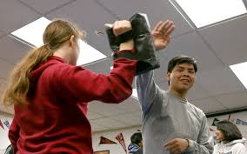
Phase 7 - Fight Response: Natural Aggression Vs. Violence
Nervous system naturally expands and contracts.
Trauma causes exaggerated desire to expand and contract (rage vs. freeze).
Healthy aggression is midway point.

Slide 18
Phase 7 - Fight Response: Natural Aggression Vs. Violence
After regulation/pendulation phase and after noticing sensation(s), ask client what their body wants to do (i.e. move, turn, run etc)
If their intention is towards expansion, try the following exercises.

Slide 19
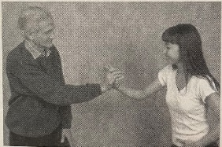
Phase 7 - Fight Response: Natural Aggression Vs. Violence
Pushing hand exercise to feel healthy aggression.
Have client push slowly into your hand (or push up against wall).

Slide 20
Phase 7 - Fight Response: Natural Aggression Vs. Violence
Back to back (back on wall)
Have client make breaststroke movement and feel the sensations

Slide 21
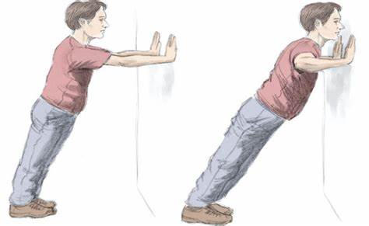
Phase 7 - Fight Response:
Natural Aggression Vs. Violence

Slide 22
Notes:
https://youtu.be/6Hj1rPrfom4

