Slide 1
Mind/Body & Soul
Trauma Healing
Life Coaching Program

Slide 2
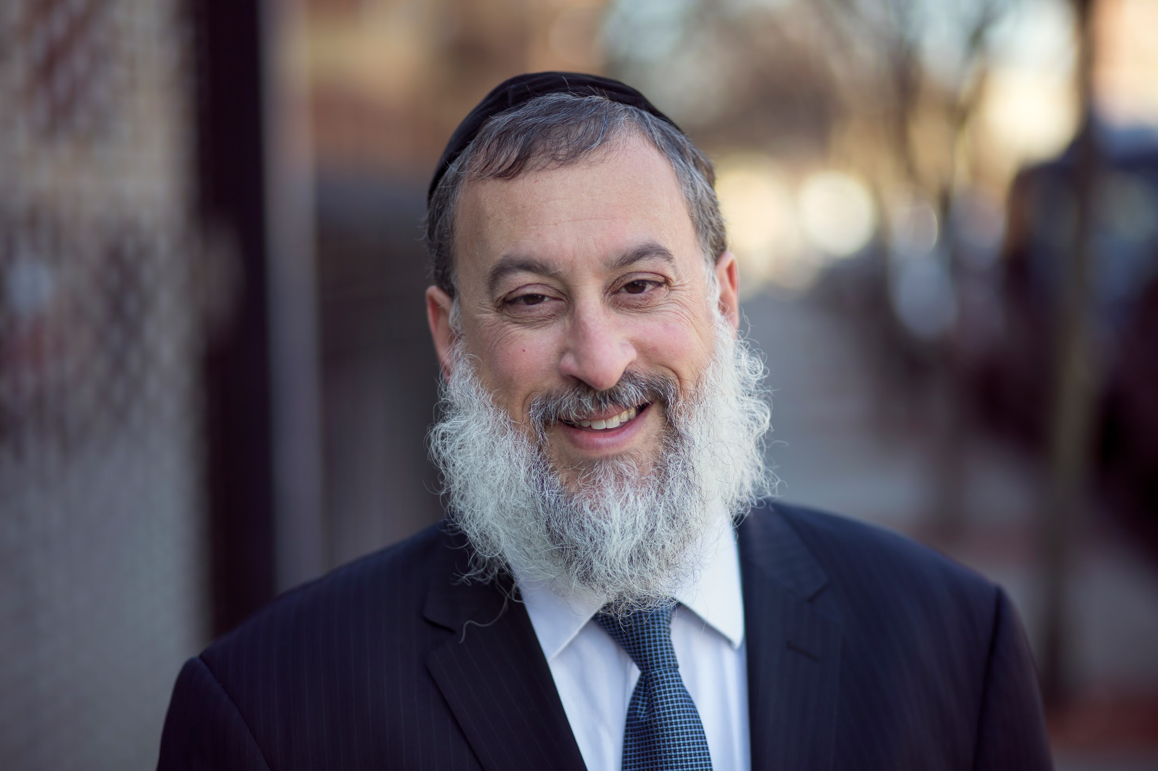
Hello!
Rabbi Daniel Schonbuch, MA, LMFT
Licensed Marriage and Family Therapist

Slide 3
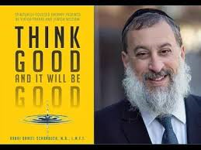
About me
Rabbi Daniel Schonbuch, LMFT
Therapist: Individuals & Couples: Depression/Anxiety, Intimacy,
Addiction
Trauma-EMDR, TF-CBT
Somatic Therapy, Sarno
Logotherapy
TorahPsychology.org Conferences
Adjunct Professor
Coach
Notes:
he focus of coaching is the coaching client relationship.
People participate in coaching because I want things to be different. And looking for change or they have important goals. They may be motivated to cheat specific goals to write a book start a business for the help of a healthier body.
Sometimes people just want more peace of mind less confusion and less financial pressures. All of this begins with during Kochi towards motivation
One of the focuses of this program will be the coactive coaching model.
There are 4/4 cornerstone.
People are naturally creative in capable of finding answers
Focus on the whole person that means they are thoughts feelings and actions relationships in their body
Dance in the moment. Every moment is an opportunity to listen or deeply and to create a new tone mood for this means we have to be able to dance with the client to follow your lead.
Evoke transformation.
The coach is able to take the entire person of him and with the coach he hold two and model of the vision that they want to achieve. The key here however is to look for the connection between igniting today's goals in life potential visit. This is what we call transformation. It moves a person from the satisfaction of ahh to breakthrough awareness of aha finding a new strength for covering a renewed capacity. It's like finding a muscle didn't know you had or had forgotten. This brings towards a deeper awareness that the coach he has an expanded capacity to reach his or her capacity potential. Another words provoking transformation means that the coach plays eight dynamic role of holding the vision of what is possible

Slide 4
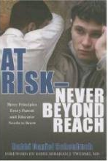
Author
Think Good and It Will Be Good: Spiritually-Based Therapy Inspired by Viktor Frankl and Jewish Wisdom
At Risk - Never Beyond Reach: Three Principles Every Parent and Educator Needs to Know
Inspirational Therapy (July, 2023)
Notes:
he focus of coaching is the coaching client relationship.
People participate in coaching because I want things to be different. And looking for change or they have important goals. They may be motivated to cheat specific goals to write a book start a business for the help of a healthier body.
Sometimes people just want more peace of mind less confusion and less financial pressures. All of this begins with during Kochi towards motivation
One of the focuses of this program will be the coactive coaching model.
There are 4/4 cornerstone.
People are naturally creative in capable of finding answers
Focus on the whole person that means they are thoughts feelings and actions relationships in their body
Dance in the moment. Every moment is an opportunity to listen or deeply and to create a new tone mood for this means we have to be able to dance with the client to follow your lead.
Evoke transformation.
The coach is able to take the entire person of him and with the coach he hold two and model of the vision that they want to achieve. The key here however is to look for the connection between igniting today's goals in life potential visit. This is what we call transformation. It moves a person from the satisfaction of ahh to breakthrough awareness of aha finding a new strength for covering a renewed capacity. It's like finding a muscle didn't know you had or had forgotten. This brings towards a deeper awareness that the coach he has an expanded capacity to reach his or her capacity potential. Another words provoking transformation means that the coach plays eight dynamic role of holding the vision of what is possible

Slide 5
Accreditation
You will be an accredited life coaching from the Torah Psychology School of Coaching & Counseling accredited by the ICF (International Coaching Federation).
30 credit hours towards 60 credit diploma with the ICF ACC (Associated Certified Coach) Portfolio Path: https://coachfederation.org/
30 CE’s for LMHC, LMFT, LMSW issued by Nefesh International.
Zoom attendance reports taken.

Slide 6
Video recordings
I try to send the video recording of the class each week within 24 hours.
However, you must download it asap each week since it is not up for more than a few days.

Slide 7
Intro to Trauma
1

Slide 8
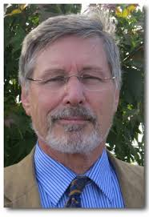
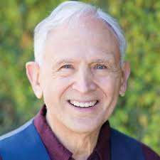
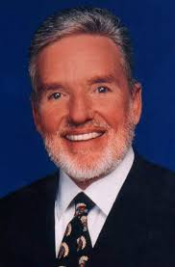
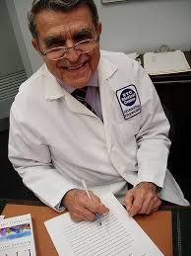
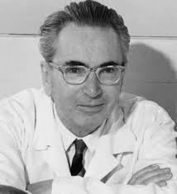
Mind/Body/Soul
Bessel van der Kolk, MD
Peter Levine, PhD
John Sarno, MD
Lucia Capacchione, PhD
Viktor Frankl, MD
Torah & Chassidic Sources

Slide 9
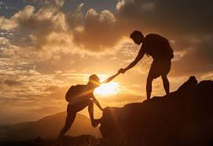
Who is the program for?
People who want to heal trauma
People who have been through their own trauma and can help others heal.
Coaches wanting to treat trauma
Therapists who want to learn new skills

Slide 10
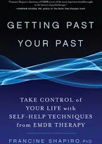
Books
Healing Trauma - Dr. Peter Levine
The Body Keeps the Score - Dr. Bessel van der Kolk
The Divided Mind - John Sarno, MD
Getting Past Your Past - Dr. Francine Shapiro

Slide 11
The need
The spread of trauma is so pervasive that we need a generation of individuals who can share insight and guidance informed by therapy, neuroscience, coaching, cultural wisdom and tradition.
This may include family, friends etc.

Slide 12
The need
This is not psychotherapy.
It is a form of education on how the body can heal itself from trauma based on the latest research in neuroscience and inspired by Jewish wisdom and spirituality.

Slide 13
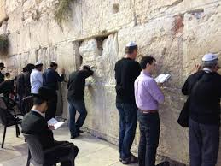
The need
Different societies have traditions and spiritual/creative modalities that have healed for individuals for generations and can inform therapy and coaching.

Slide 14
Emotional Healing
Similar to an EMT, hotline volunteer or first responder, you will learn how to offer an informed approach to “emotional” first aid.
Empathy and compassion are the two most powerful tools in healing trauma.

Slide 15
Learned from Ethology
In fact, according to Levine, we also have much to learn from the animal kingdom and how one’s physical body needs to dispel it’s survival energy after trauma and regain its vibrancy.

Slide 16
Disclaimer
We do not aim to diagnose and treat physical illness.
Clients should always first consult with a physician before treating any psychosomatic pain.

Slide 17
Referring
Be open and direct with clients when informing them about your training.
When in doubt, ask for supervision and advice, or refer to licensed professionals.

Slide 18
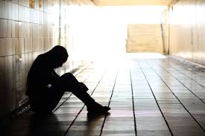
Referring Out
Cases of sexual abuse, severe trauma (PTSD), significant depression/anxiety or suicidal ideation must be referred to a licensed mental health professional/physician etc.
Finally, if people feel overwhelming sensations of rage or helplessness they should be referred to a mental health professional.

Slide 19
Research vs Mesearch
We will be presenting a neuroscientific perspective on trauma and pain.
In order to treat trauma it is important to explore and help heal your own traumas.
Each class will present exercises and homework for self-exploration.

Slide 20
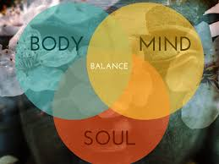
Mind/Body/Soul Connection

Slide 21
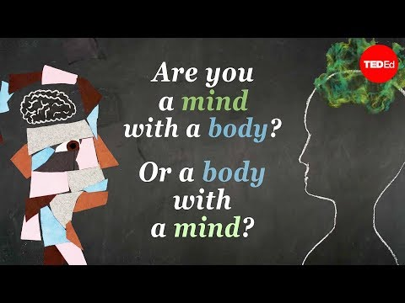
Are you a Mind with a Body, or Body with a Mind?
Notes:
https://www.youtube.com/watch?v=ILDy6kYU-xQ
Until 2:23 then at 2:43 till 5:00

Slide 22
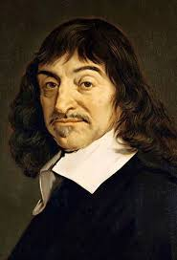
Is there a separation between body and mind?
“I think, therefore I am.”
Descartes
Mind & Body

Slide 23
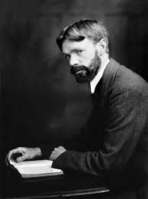
“The body unconscious is where the life bubbles up in us. It is how we know we are alive. Alive to the depths of our souls and in touch somewhere with the vivid reaches of the cosmos.”
D.H. Lawrence
Body, Mind, Soul

Slide 24
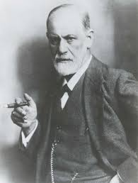
Freud on Mind/Body
Humans are animals with inborn biological "drives" for sex and aggression.
Body with a Mind

Slide 25
Freud on the Soul
By soul Freud meant the psyche, which takes in what the writer calls the It, the I, and the Above-I (commonly translated as the Ego, the Id, and the Super-Ego).
Mind/Body

Slide 26
Freud on the Soul
Regarded God as an illusion, based on the infantile need for a powerful father figure; religion, necessary to help us restrain violent impulses earlier in the development of civilization, can now be set aside in favor of reason and science.
Mind/Body

Slide 27
Frankl on the Mind/Body & Soul
“If man is just a bag of chemicals, what is the purpose of his life?”
Mind/Body & Soul

Slide 28
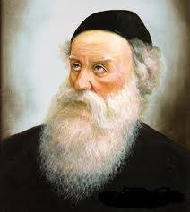
Baal HaTanya
These are two nefashot²⁸—two souls and life-forces.
It is this nefesh that is clothed in the blood of a human being, giving life to the body, sustains physical and corporeal life) is in the blood.”²⁹
Mind/Body & Soul

Slide 29
Baal HaTanya - G-dly Soul
And He blew into his nostrils a soul of life,” (Genesis 2:7)
“You blew [it] into me.” [a G-dly soul] (Siddur) for it is of his inward and innermost vitality that a man emits through blowing with force.
Mind/Body & Soul

Slide 30
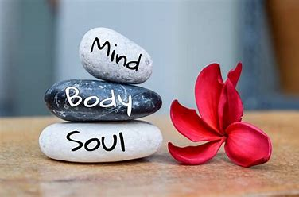
The Great Debate on Influence
Mind
Body
Soul
BODY

Slide 31
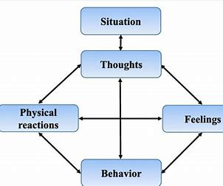
Aaron Beck (CBT)
Mind
Emotions
Body (Actions)

Slide 32
Beck
Robber at the window
Leaves

Slide 33
Sarno
Mind Represses
Emotions (rage)
Body is a distraction
Anger/Perfectionism

Slide 34
Van der Kolk and Levine’s Model
Soul - Spirituality
Mind - Positivity
Body - Safety

Slide 35
Trauma and Experience
A person who experiences trauma will find it difficult to access the higher levels of his/her thoughts or spirit unless he/she first feels safe.

Slide 36
Erik Erikson
Stage 1: Trust vs. Mistrust.
Stage 2: Autonomy vs. Shame and Doubt.
Stage 3: Initiative vs. Guilt.
Stage 4: Industry vs. Inferiority.
Stage 5: Identity vs. Confusion.
Stage 6: Intimacy vs. Isolation.
Stage 7: Generativity vs. Stagnation.

Slide 37
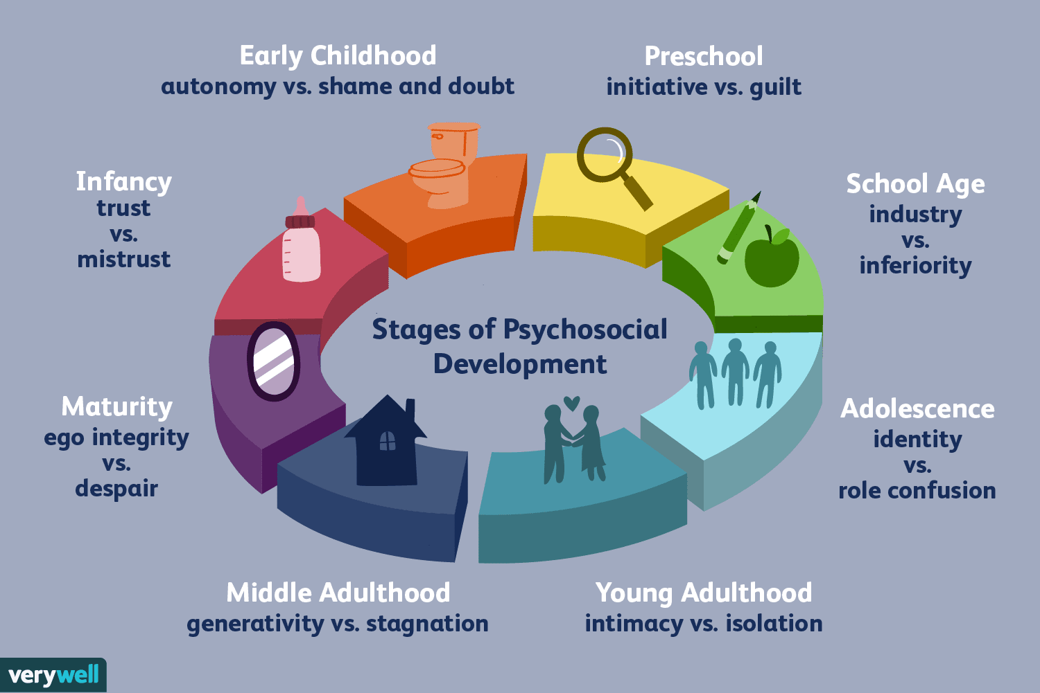

Slide 38
Stages & Similarities
Note the similarities between unresolved crises and symptoms of trauma.
That is where the client is.

Slide 39
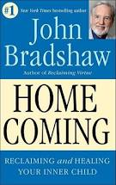
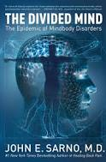
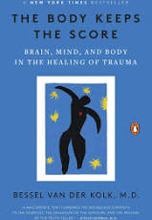
Soul - Spirituality
Mind - Positivity
Body - Safety

Slide 40
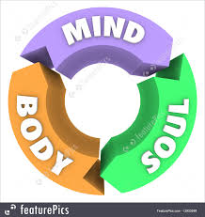
Integration of all 3
Body: Fight/Flight/Freeze
Mind - Anger/Self Beliefs
Soul - Lack of Meaning

Slide 41
ואחר עורי נקפו זאת ומבשרי אחזה אלקה
"Though my skin has been torn from my body [due to my many afflictions], [still] from my flesh I perceive G‑d."
Iyov 19:26.
There is a lot to learn from the body.
Notes:
https://www.chabad.org/library/article_cdo/aid/67778/jewish/Discourse-15.htm#footnote1a67778

Slide 42
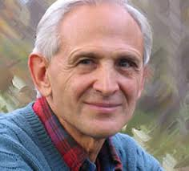
Peter Levine maintains that trauma is a form of freeze and even death.
Transforming trauma is like being born again. Like the soul re-entering in the body.
This will also be addressed when discussing Viktor Frankl, meaning and spirituality.
Notes:
https://www.chabad.org/library/article_cdo/aid/67778/jewish/Discourse-15.htm#footnote1a67778

Slide 43
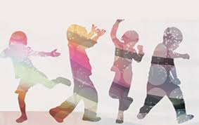
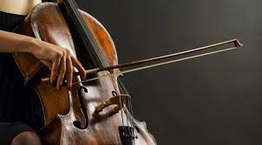
Explore Several Modalities
Somatic Coaching
Sarno Method
Sensorimotor
Movement and Music
EFT - Tapping
Storytelling
Logotherapy/Spirituality

Slide 44
What is Trauma?

Slide 45
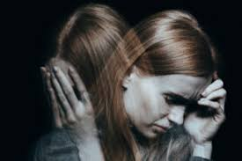
What is Trauma?
“Trauma is a breach in the protective barrier to protect oneself against overstimulation leading to overwhelming feelings of helplessness.”
Peter Levine

Slide 46
In trauma a person loses a part of him/herself and their:
Inner child
Vibrancy
Inner talents & aspirations
Basic survival energy

Slide 47
Types
Severe distress and helplessness
Terrorism
Natural catastrophes (COVID)
Sexual assault
Child abuse
Neglect or Violence

Slide 48
Emotional Signs
Sadness
Anger
Denial
Fear
Shame

Slide 49
Common Physical Symptoms
Nausea
Dizziness
Altered sleep patterns
Changes in appetite
Headaches
Gastrointestinal problems
Pain

Slide 50
Psychological Symptoms
PTSD
Depression
Anxiety
Agitation
Bad mood
Dissociative disorders
Substance abuse problems

Slide 51
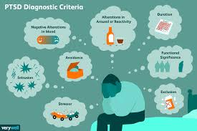
PTSD
Nightmares or flashbacks. ...
Avoidance of external reminders....
Altered anxiety state.
Changes in mood or thinking.

Slide 52
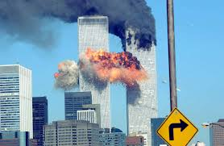
9/11
My personal experience
Traumatic effects
EMDR

Slide 53
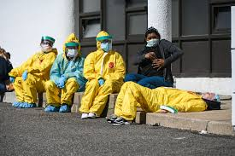
COVID Trauma
Death
Fear of illness
Isolation
Lack of attachment

Slide 54
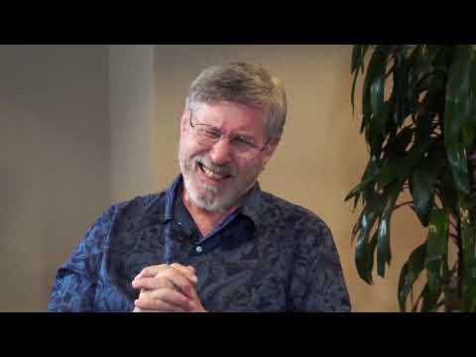
Bessel van der Kolk
Notes:
https://www.youtube.com/watch?v=jA89KNfJUEY&feature=emb_logo

Slide 55
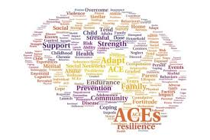
ACE Predictors
Adverse childhood experiences, or ACEs, are potentially traumatic events that occur in childhood (0-17 years).
Linked to chronic health problems, pain, mental illness, and substance misuse in adulthood.

Slide 56
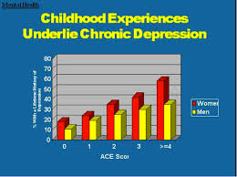
ACE Types
Experiencing violence, abuse, or neglect (or hearing about it i.e. the Holocaust)
Witnessing violence in the home or community
Mental health problems
Instability due to parental separation

Slide 57
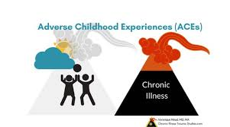
ACE Stats
ACEs are common. About 61% of adults surveyed across 25 states reported that they had experienced at least one type of ACE.
Nearly 1 in 6 reported they had experienced four or more types of ACEs.

Slide 58
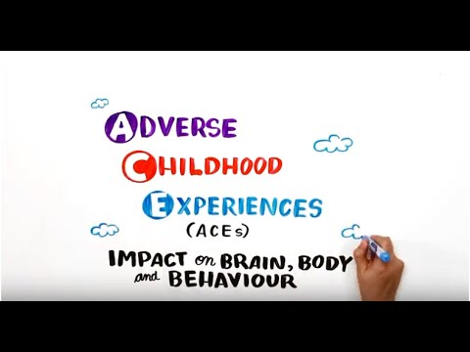
Notes:
https://www.youtube.com/watch?v=W-8jTTIsJ7Q&feature=emb_logo

Slide 59
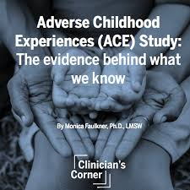
CDC-Kaiser ACE Study
The CDC-Kaiser Permanente Adverse Childhood Experiences (ACE) Study is one of the largest investigations of childhood abuse and neglect and household challenges and later-life health and well-being.

Slide 60
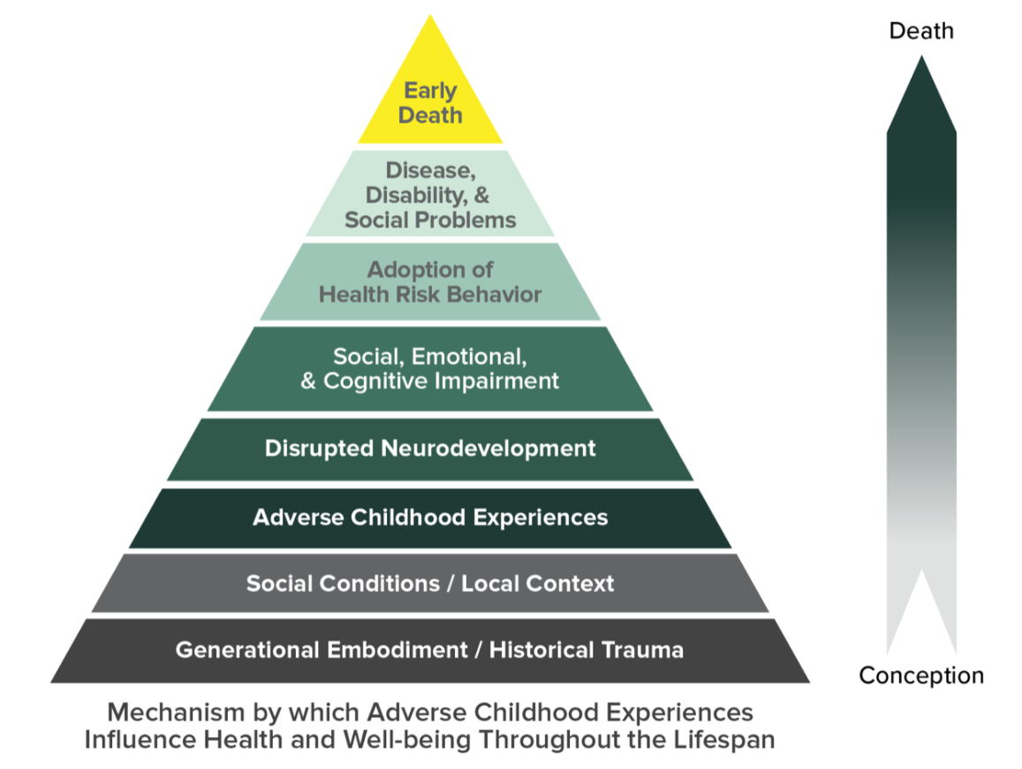

Slide 61
Somatic symptoms
We cannot understand why people suffer with unexplainable somatic symptoms for many years where physicians to not help.
Pain is embodied in the nervous system unless we address its cause.

Slide 62
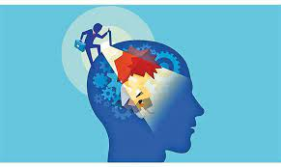
Awareness Exercise
Notes:
https://www.chabad.org/library/article_cdo/aid/67778/jewish/Discourse-15.htm#footnote1a67778

Slide 63
The Body Keeps the Score
Bessel Van der Kolk

Slide 64
“The essence of trauma is that it is overwhelming, unbelievable, and unbearable. Each patient demands that we suspend our sense of what is normal and accept that we are dealing with a dual reality: the reality of a relatively secure and predictable present that lives side by side with a ruinous, ever-present past.”
― Bessel A. van der Kolk, The Body Keeps the Score: Brain, Mind, and Body in the Healing of Trauma

Slide 65
Bessel van der Kolk
Revolutionized the way we look at trauma.
It is not just a psychological problem
Trauma actually changes the body and not only the mind.
He studied the disconnection from the body that so many people with histories of trauma and neglect experience daily.

Slide 66
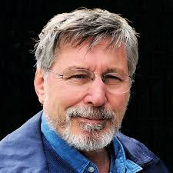
Bessel van der Kolk
Traumatized people chronically feel unsafe inside their bodies: The past is alive in the form of gnawing interior discomfort.
.

Slide 67
Bessel van der Kolk
Their bodies are constantly bombarded by visceral warning signs, and, in an attempt to control these processes, they often become expert at ignoring their gut feelings and in numbing awareness of what is played out inside.
.

Slide 68
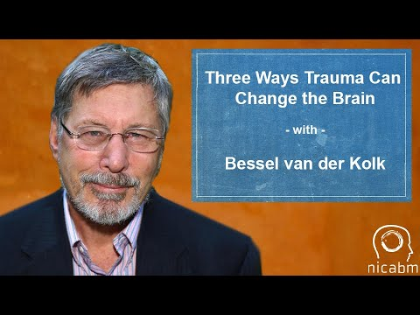
Van der Kolk: COVID Trauma
Notes:
https://www.youtube.com/watch?v=fVOt_KOT8Zk&feature=emb_logo

Slide 69
Bessel van der Kolk
“Psychologists usually try to help people use insight and understanding to manage their behavior.
However, neuroscience research shows that very few psychological problems are the result of defects in understanding……”

Slide 70
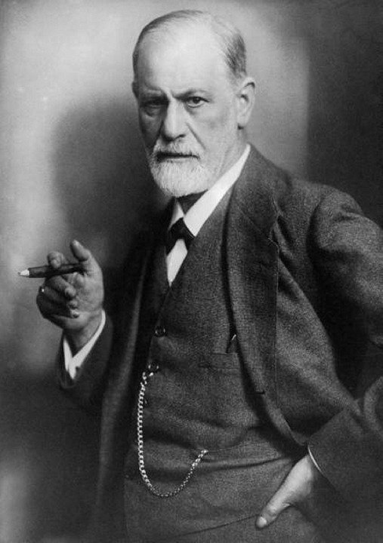
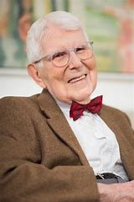
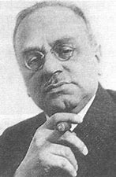
Bessel van der Kolk
Pleasure
Self Belief
Power
This challenges most of modern psychology which focuses on the mind………………..

Slide 71
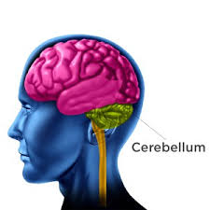
Bessel van der Kolk
“…..most originate in pressures from deeper regions in the brain that drive our perception and attention.
When the alarm bell of the emotional brain keeps signaling that you are in danger, no amount of insight will silence it.”

Slide 72
Bessel van der Kolk
“Trauma is held in procedural memory (instincts) - in autonomic actions and reactions, sensations, and attitudes and replayed and reenacted as visceral (deep body) sensations, body movements, nightmares”
Van der Kolk on Pierre Janet, L’automatism pscyhologique”.

Slide 73
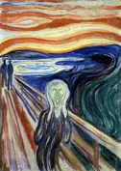
Bracing against feelings
The mind may first experience emotional sufferings, but then the body ends up “keeping the score”.
“Oh no!” - Body bracing reaction

Slide 74
Resources
https://www.torahpsychology.org/mindbodyresources4

Slide 75
Trauma Journal 1
See resources page

