Slide 1
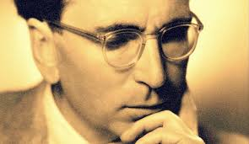
Viktor Frankl Addiction Recovery Coaching
Week 4

Slide 2
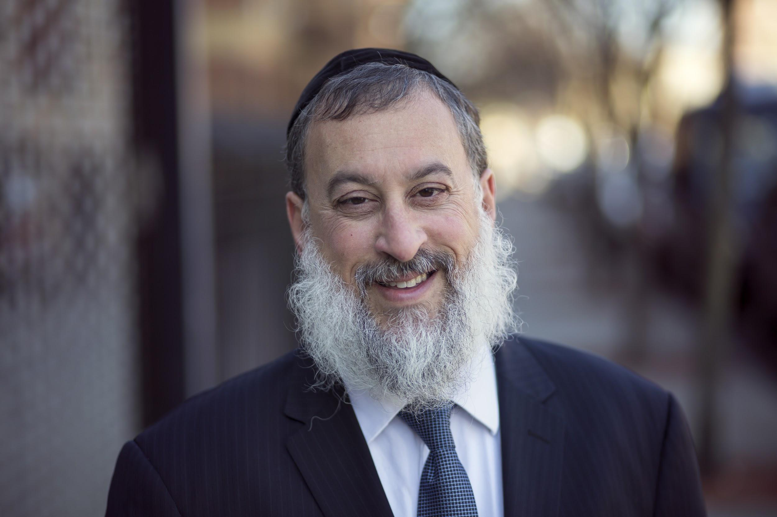
Week 4
Negative Core Beliefs
Erikson stages
Addiction Recovery Coaching
Empathy
Co-occurring Disorders
12 Steps
WRAP
Compassionate Inquiry

Slide 3
Negative Core Beliefs
I am basically bad, unworthy person (low self esteem)
No one would love me as I am (unlovable)
My needs are never going to be met if I have to depend on others (anti-dependent).
(Drugs/Sex) is my most important need.
Notes:
‹#›

Slide 4
The Addictive Cycle
Belief System
Unmanageability
Impaired Thinking
Addictive Cycle
Preoccupation
Shame
Despair
Ritualization
Guilt
Compulsive Behavior
© 2008
Notes:
‹#›

Slide 5
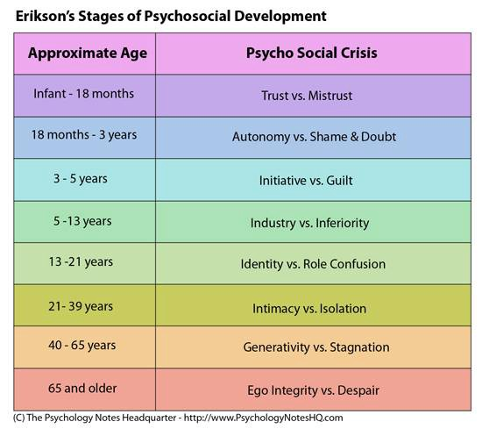
Notes:
‹#›

Slide 6
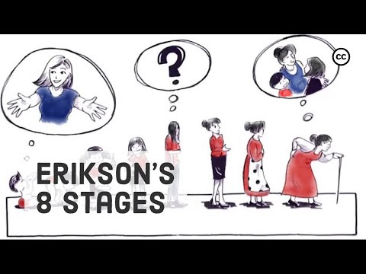
Notes:
‹#›

Slide 7
Addiction Recovery Coaching
Empathy (Trust etc.)
Coaching (Recovery Plan)
12 step support groups
Relapse Prevention

Slide 8
Empathy
Empathy for the user’s inner experience and pain
(Oxytocin - “tend and befriend
hormone”)
Fundamental to developing trust

Slide 9
Empathy
Active Listening
Reflection
Paraphrasing

Slide 10
Coaching - Recovery Plan
Identify goals for achieving wellness
Specify steps to take reach those goals
Consider both daily activities and longer term goals

Slide 11
Coaching - Recovery Plan
Track your progress (Dopamine)
Identify triggers and ways to manage them

Slide 12
Coaching
Offer healthier lifestyle alternatives:
Relationships, activities, exercise (Dopamine, Oxytocin, Endorphins)
Creativity, Exercise, Music, Volunteering (Dopamine)

Slide 13
Coaching - Resources
Education
Work
Housing
Jobs
Notes:
https://www.recovery.org/pro/articles/developing-your-personal-recovery-plan-template-included/

Slide 14
12 Steps
Promote 12 step/support groups
(Dopamine - social reward is processed in the same brain reward centers in the limbic system as non-social reward and drug addiction)

Slide 15
Spiritual Growth
65% increase in endogenous dopamine release
Increase in the serotonin levels during meditation
https://www.ncbi.nlm.nih.gov/pmc/articles/PMC3190564/

Slide 16
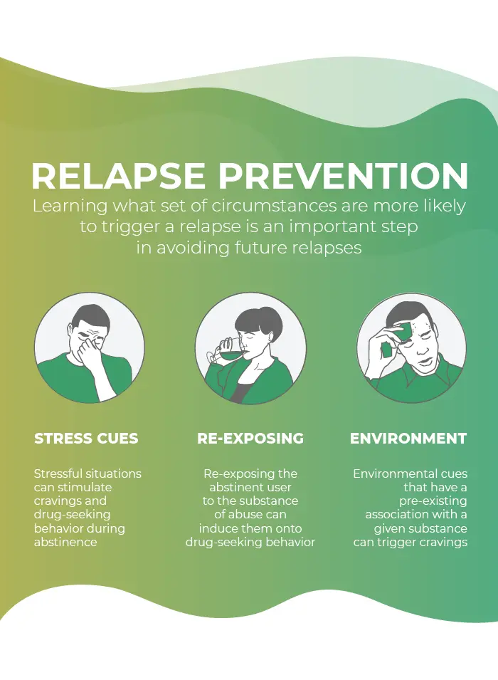
4. Relapse Prevention
Stress Cues
Re-Exposing
Environment

Slide 17
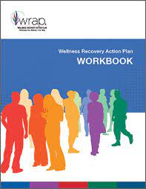
The Wellness Recovery Action Plan® or WRAP®, is a self-designed prevention and wellness process
Developed to help addiction and mental health and help people their life dreams and goals.

Slide 18
Co-Occurring Disorders
Is a term for a person who experiences a mental illness and a substance use disorder at the the same time.
It is sometimes called a “co-occurring disorder” because both the addiction and mental health issue occur together.
Notes:
The focus of coaching is the coaching client relationship.
People participate in coaching because they want things to be different. And looking for change or they have important goals. They may be motivated to cheat specific goals to write a book start a business for the help of a healthier body.
Sometimes people just want more peace of mind less confusion and less financial pressures. All of this begins with during coaching towards motivation
One of the focuses of this program will be the coactive coaching model. This incredible system is based on the idea that we as coaches focus on the clients agends and not on ours. They define the agenda and we are their to help them in their journey.
We need to help them articulate their dreams, desires, and aspirations, thel them clarify theri mission, puropsle and goals and help them achieve that outcome.

Slide 19
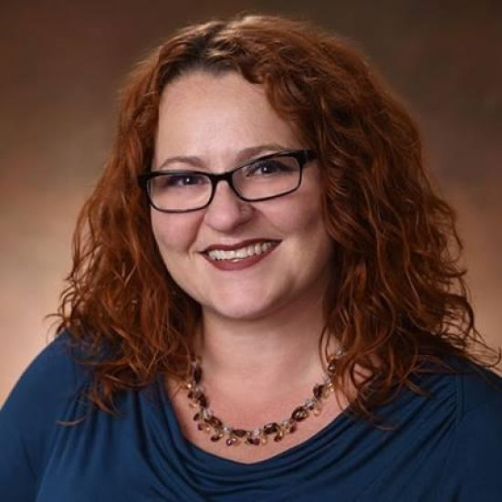
Julia Loytsker, Psy.D. is a Staff Psychologist working with Relapse patients.
She is a clinical psychologist, licensed in Pennsylvania. Dr. Loytsker earned her Doctorate of Psychology from Widener University.

Slide 20
She has received additional training behavioral therapy (CBT), motivational interviewing, and dialectical behavior therapy (DBT). H
Dr. Loytsker’s pre-doctoral and post-doctoral internships were completed in settings offering treatment for addiction and co-occurring disorders.

