Slide 1
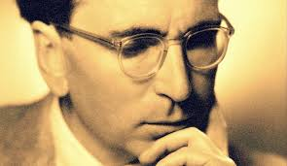
Viktor Frankl Addiction Recovery Coaching
Week 9

Slide 2
Dr. Dominique Simone-Levine AlliesinRecovery.net

Slide 3
Dominique Simone-Levine PhD, MPH
Dr. Simone-Levine is a facilitator and a trained speaker on issues of addiction and the family based in MA
Substance Abuse Researcher
Family drug and alcohol interventionist
Dominique launched Allies in Recovery in 2003.
Notes:
https://www.youtube.com/watch?v=VAAmSqv2GV8

Slide 4
CRAFT MODEL
CRAFT (Community Reinforcement Approach to Family Training) is a system for helping friends and family members change the way that they are interact with someone they love who is drinking or using drugs too much.
Notes:
https://www.youtube.com/watch?v=VAAmSqv2GV8

Slide 5
CRAFT MODEL
Research on CRAFT shows that approaching 70% of families who receive CRAFT are able to help their loved ones start treatment within a year
Helps family members improve their own lives, whether their loved one ends up seeking treatment or not.
Notes:
https://www.youtube.com/watch?v=VAAmSqv2GV8

Slide 6
Laurie MacDougall

Slide 7
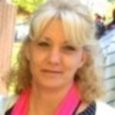
Laurie MacDougall
Former Math teacher
Writer
Works on Alliesinrecovery.net helping parents deals with their loved ones struggling with addiction
Exec. Director of REST
Notes:
https://www.youtube.com/watch?v=VAAmSqv2GV8

Slide 8
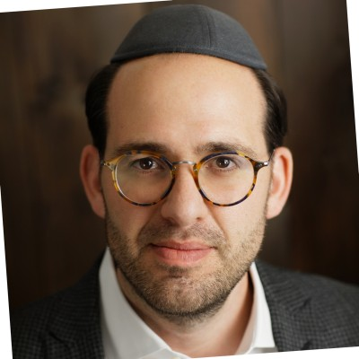
Menachem Poznanski, LCSW
Meaning centered therapy, that supports individuals in their self-discovery, interpersonal relationships, and personal development.
Notes:
https://www.youtube.com/watch?v=VAAmSqv2GV8

Slide 9
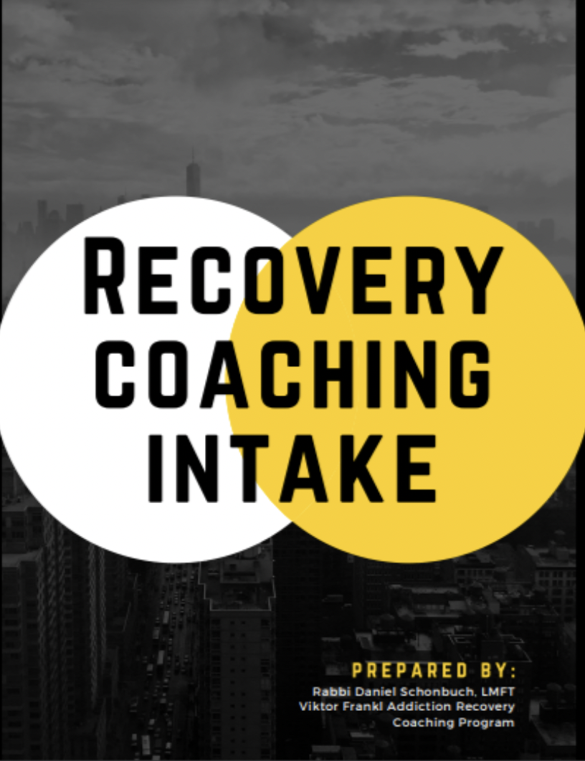
Notes:
https://www.recovery.org/pro/articles/developing-your-personal-recovery-plan-template-included/

Slide 10
Coaching - Recovery Plan
Identify goals for achieving wellness
Specify steps to take reach those goals
Consider both daily activities and longer term goals

Slide 11
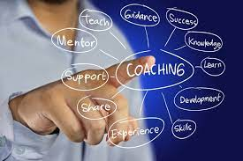
Coaching
Offer healthier lifestyle alternatives:
Relationships, activities, exercise (Dopamine, Oxytocin, Endorphins)
Creativity, Exercise, Music, Volunteering (Dopamine)

Slide 12
Coaching - Recovery Plan
Track your progress Identify triggers and ways to manage them

Slide 13
Coaching - Resources
Education
Work
Housing
Jobs
Notes:
https://www.recovery.org/pro/articles/developing-your-personal-recovery-plan-template-included/

Slide 14
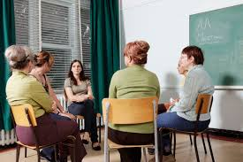
12 Steps
Promote 12 step/support groups
(Dopamine - social reward is processed in the same brain reward centers in the limbic system as non-social reward and drug addiction)

Slide 15
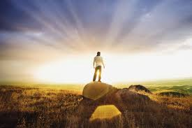
Spiritual Growth
65% increase in endogenous dopamine release
Increase in the serotonin levels during meditation
https://www.ncbi.nlm.nih.gov/pmc/articles/PMC3190564/

Slide 16
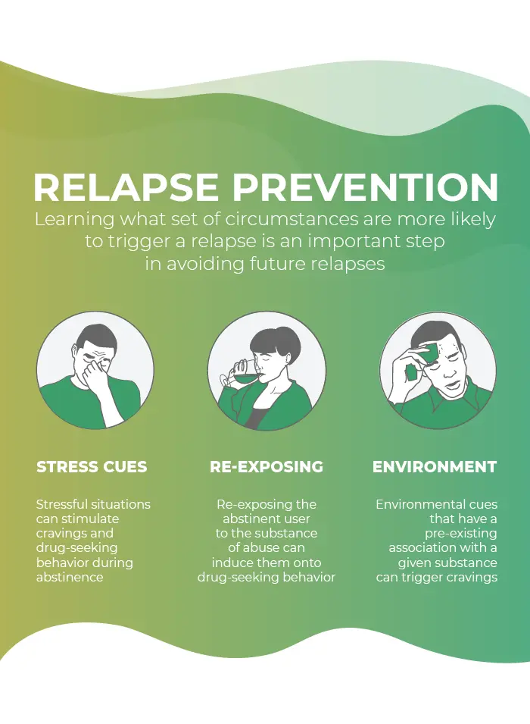
4. Relapse Prevention
Stress Cues
Re-Exposing
Environment

Slide 17
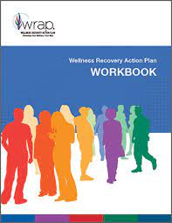
The Wellness Recovery Action Plan® or WRAP®, is a self-designed prevention and wellness process
Developed to help addiction and mental health and help people their life dreams and goals.

